Slide 1
Welcome to Ms. Rigney’s Pre-K classroom at Menands School!
2022-2023

Slide 2
Menands Pre-K started November 1st, 2021. Menands School opened their doors and arms wide for their new littlest learners.
There is a maximum of 18 children in our Pre-K classroom with 1 Teacher and 1 Teacher Assistant.
Our school has children in Pre-K through 8th Grade.

Slide 3
Our Pre-K school day starts at 8:30am and ends at 2:30pm.
Caregivers are responsible for providing transportation to and from school.
Currently breakfast and lunch are provided at no cost to families. We are waiting to hear from National School Lunch Program to see is this will continue for 22-23

Slide 4
The UPK Lottery will be held on Wednesday May 18th at the Menands Schools. Families can attend in person if they would like.
Only students who are fully registered can participate in the lottery.
If anyone has questions about registration, please contact Liz Mentiply at lmentiply@menands.org or 518-465-4561 ext 101.

Slide 5
Prekindergarten provides children with many opportunities to explore the world around them in meaningful ways. In our Pre-K classroom we have a balanced schedule that consists of teacher initiated and child initiated learning activities. There are many opportunities to engage in activities, explore materials and interact with adults and peers in meaningful ways. Throughout the year we have many different themes where we learn about some fun things such as celebrations around the world, animals, dinosaurs, space, and so much more.

Slide 6
What a day in Pre-K looks like
8:20-8:50am | Arrival - Wash Hands - Breakfast - Books
8:50 – 9:10am | Morning Meeting
9:10am–10:45am | Centers
10:45– 11:00am | Music & Movement Bathroom & Wash Hands
11:00 – 11:30am | Lunch
11:30-12:30pm | Nap/Rest Time
12:30– 12:45pm | Snack
12:45– 12:50pm | SEL/Read-Aloud
12:50– 1:45pm | Centers
1:50 – 2:00pm | Developmental Whole Group & Pack-Up
2:00-2:30pm | Recess
2:30-2:40pm | Dismissal

Slide 7
Centers
Well-defined and labeled learning centers- print rich environment
-Instructional materials and equipment intentionally arranged in learning centers
All of this supports meaningful interactions: student - student, student – teachers
At least 2 hrs and 10 minutes of center time daily- Teachers work with students during this time for differentiated instruction within small groups or individually.
Students are able to choose their centers and have free choice of what centers they go to. Centers are modified depending on the theme to enhance learning and concept development.

Slide 8
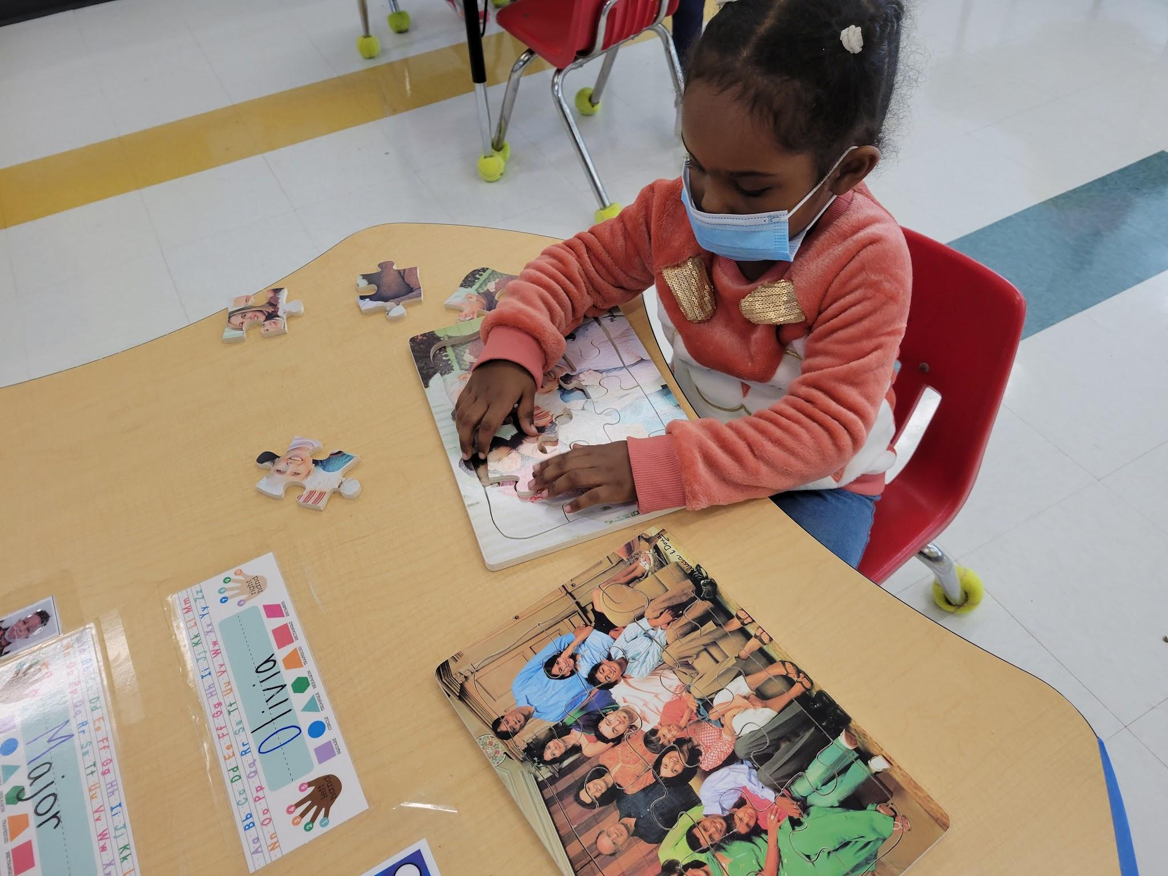
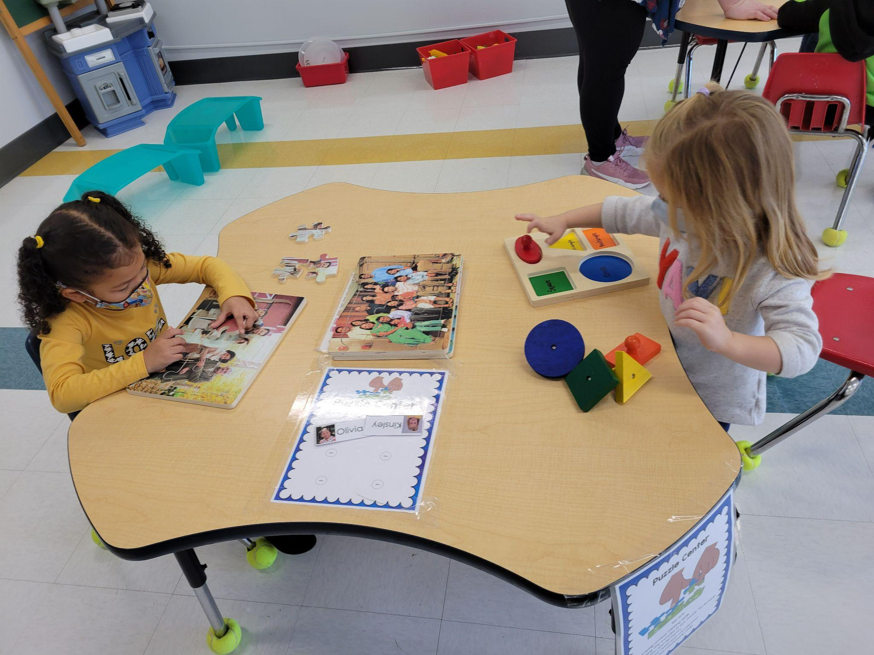
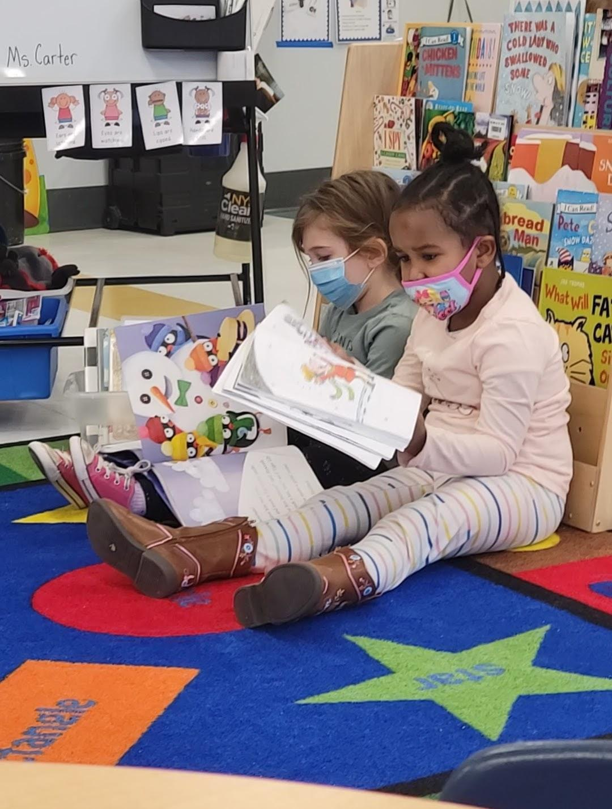
Library and Puzzle Centers

Slide 9
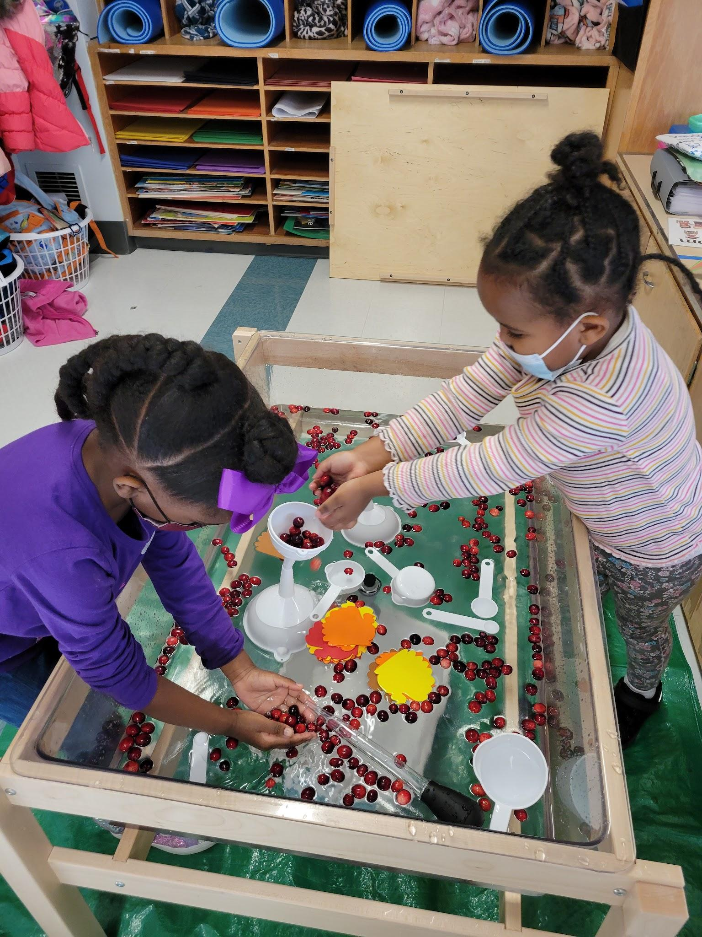
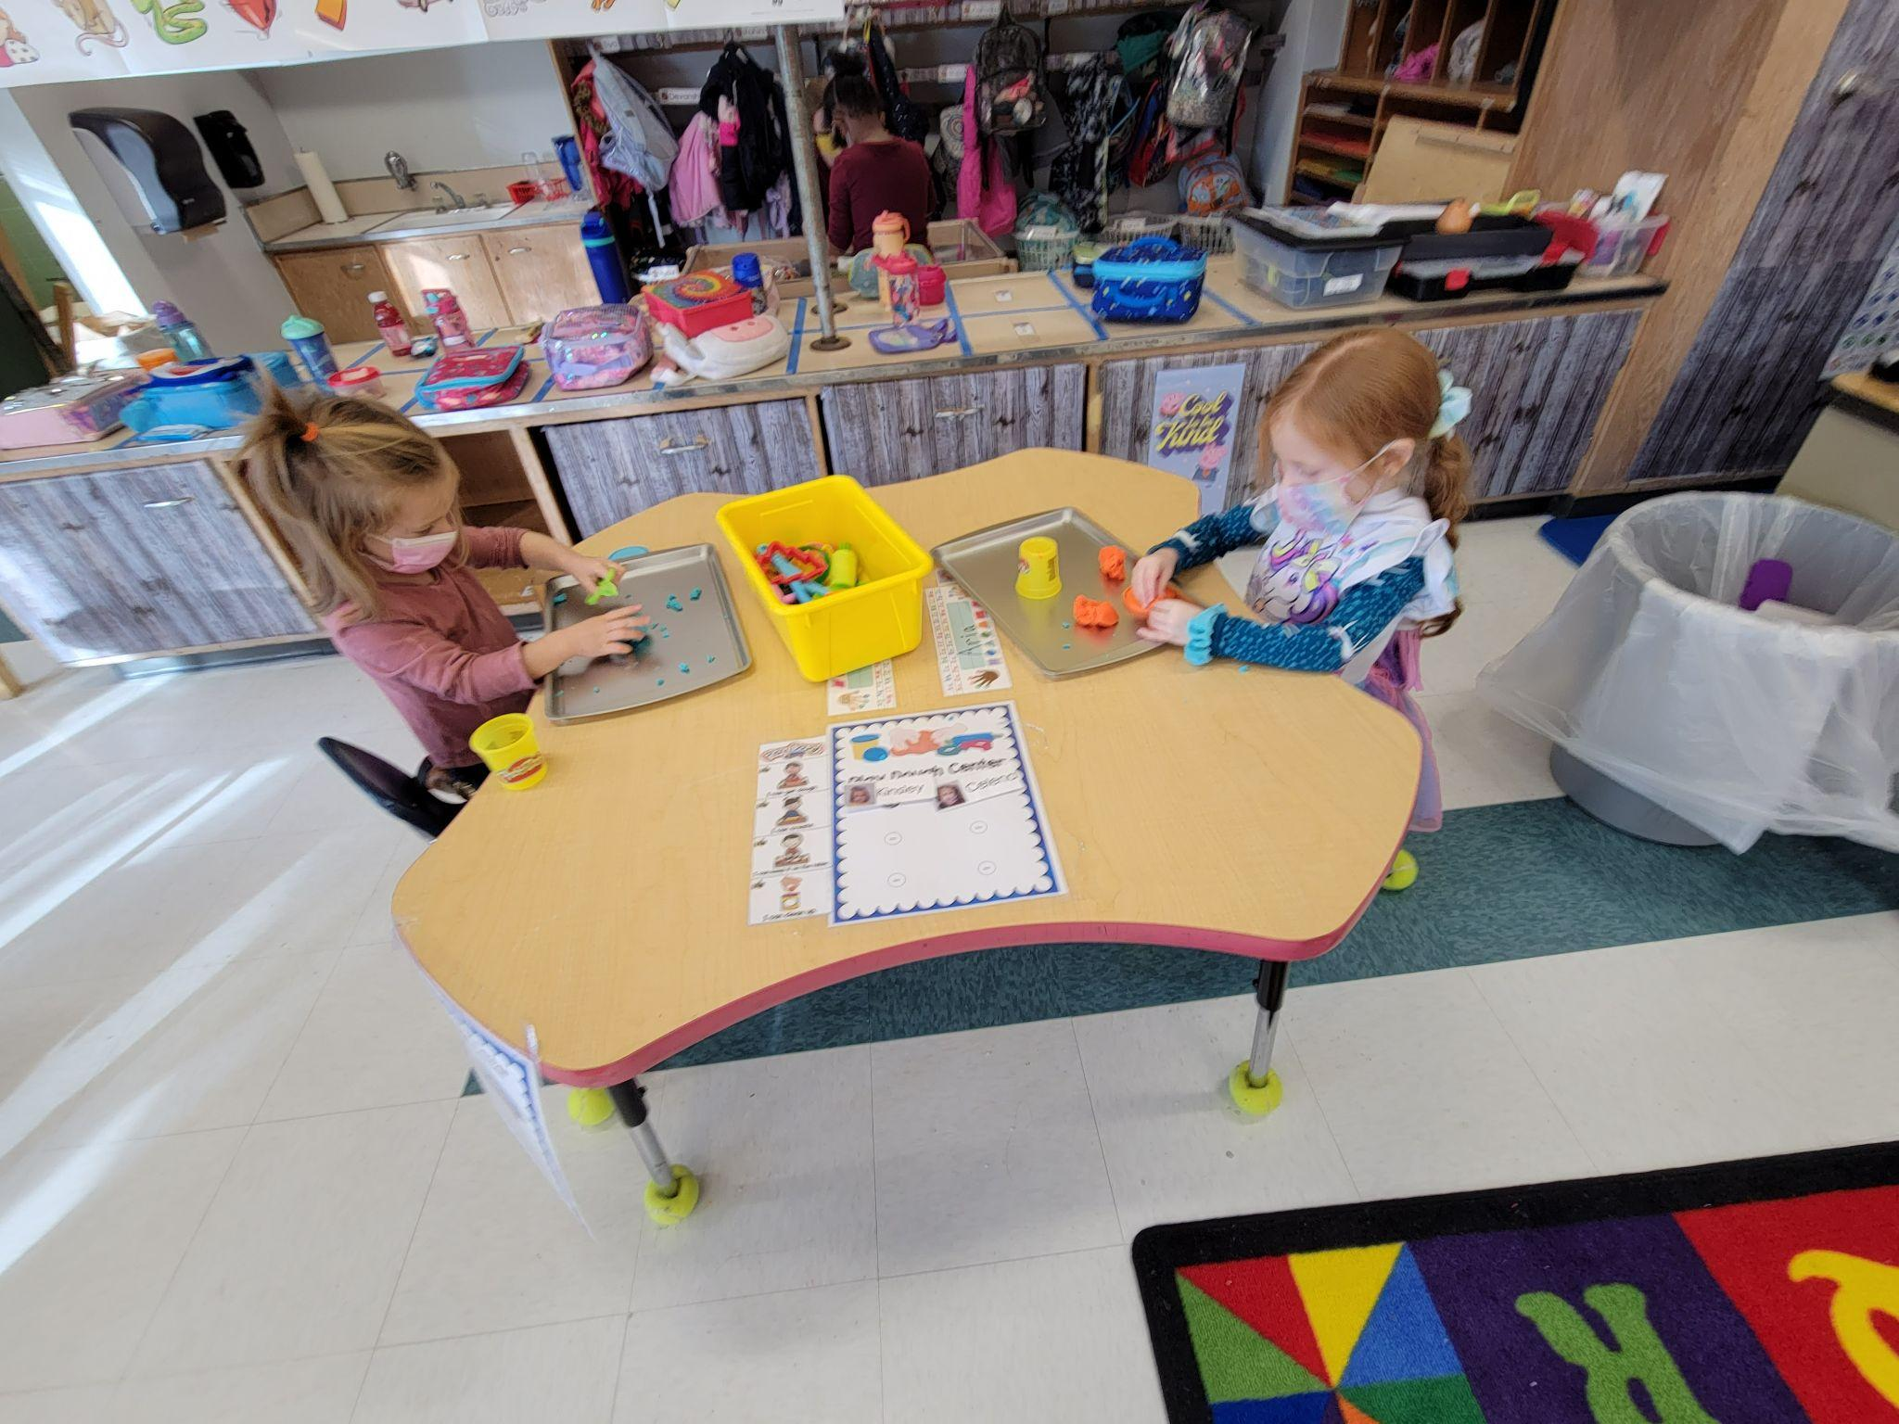
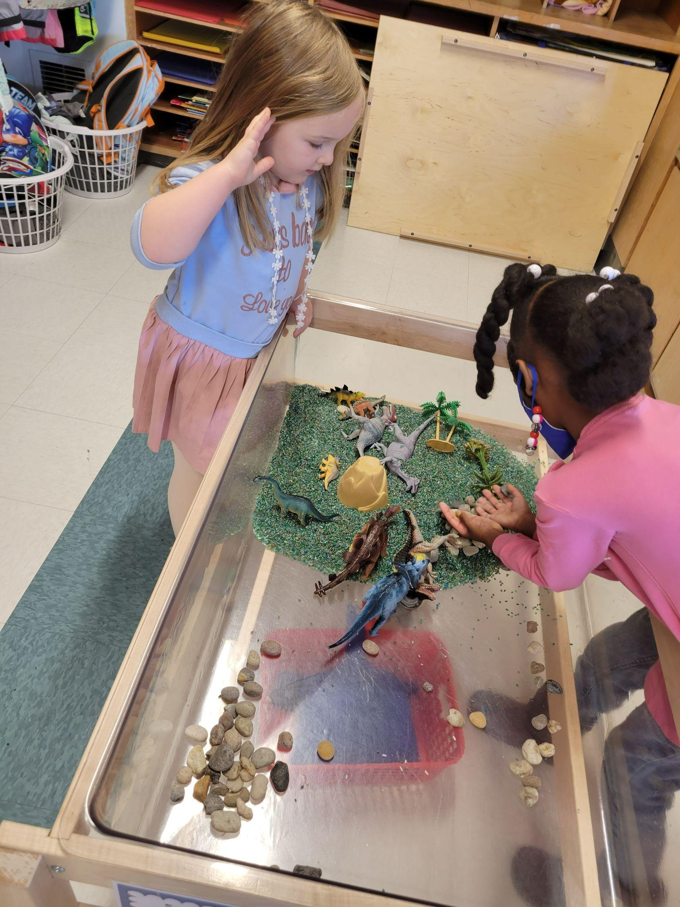
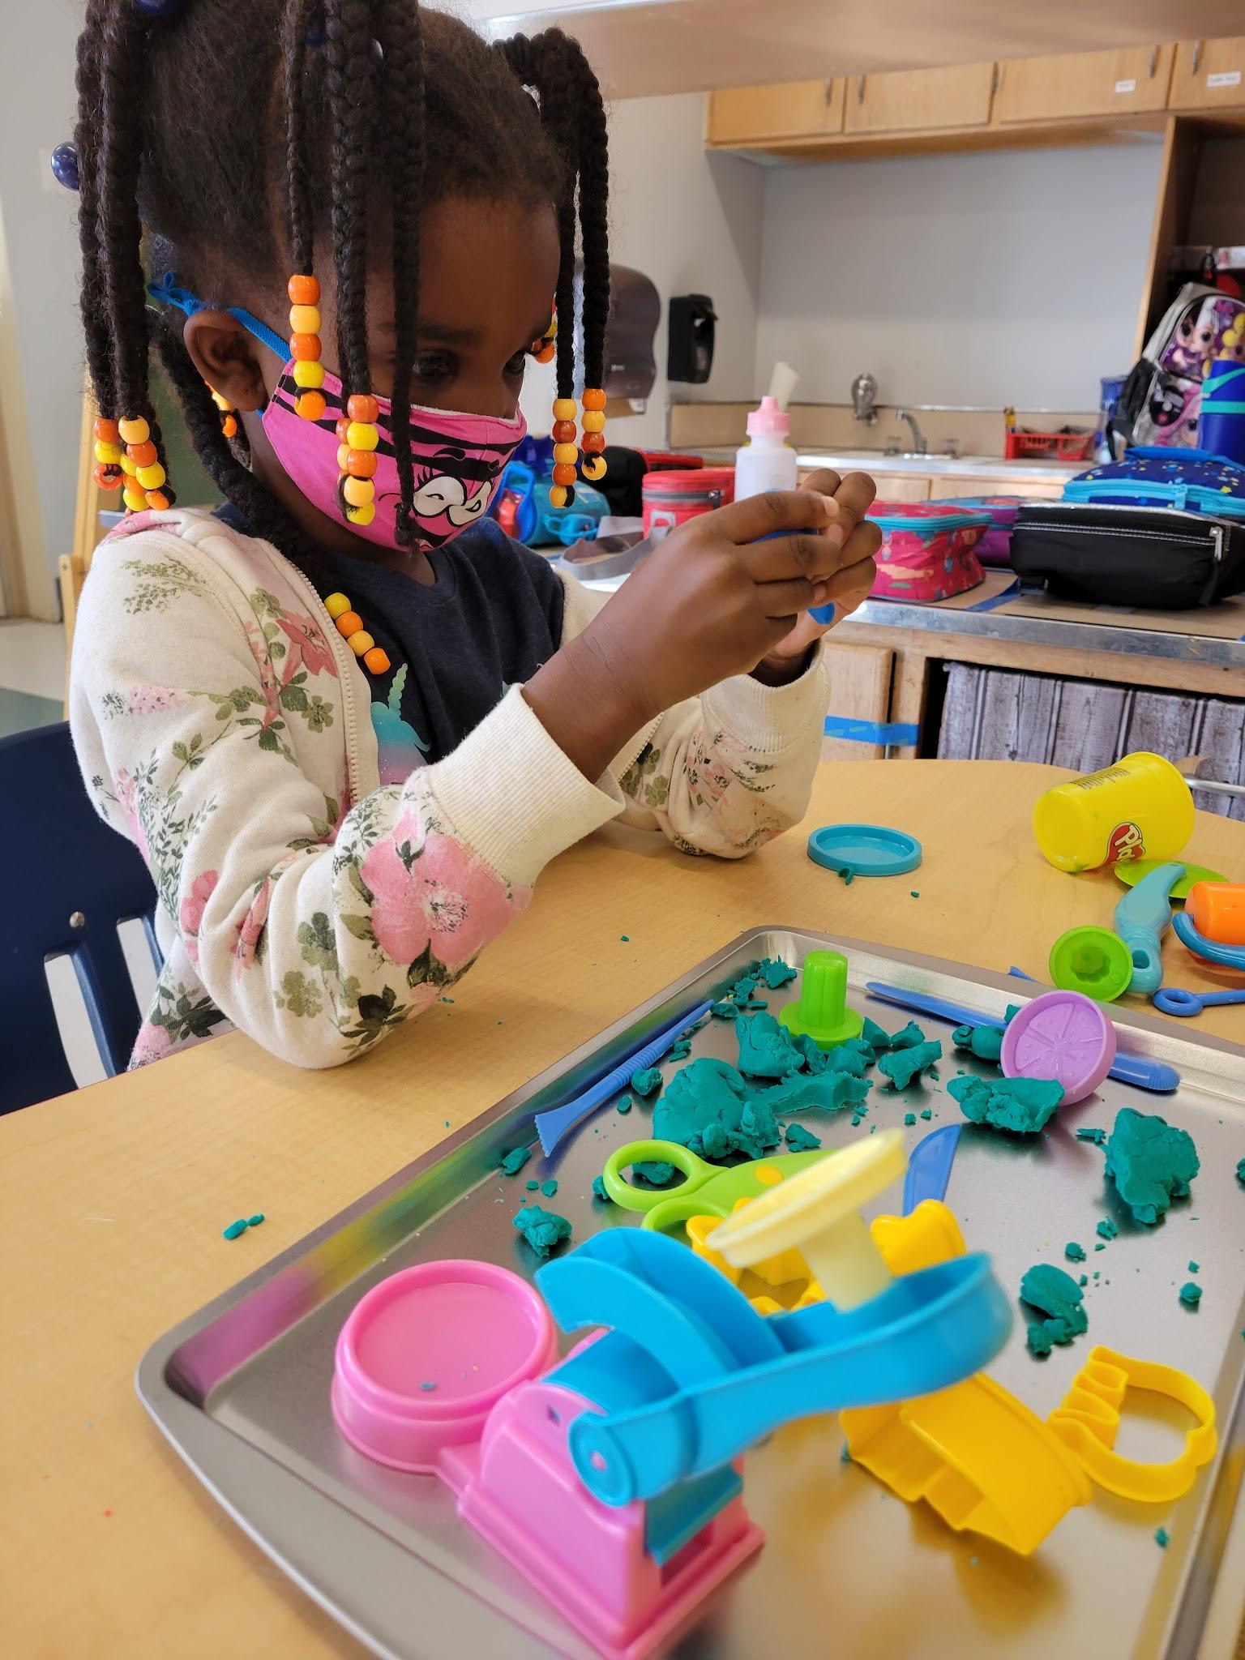
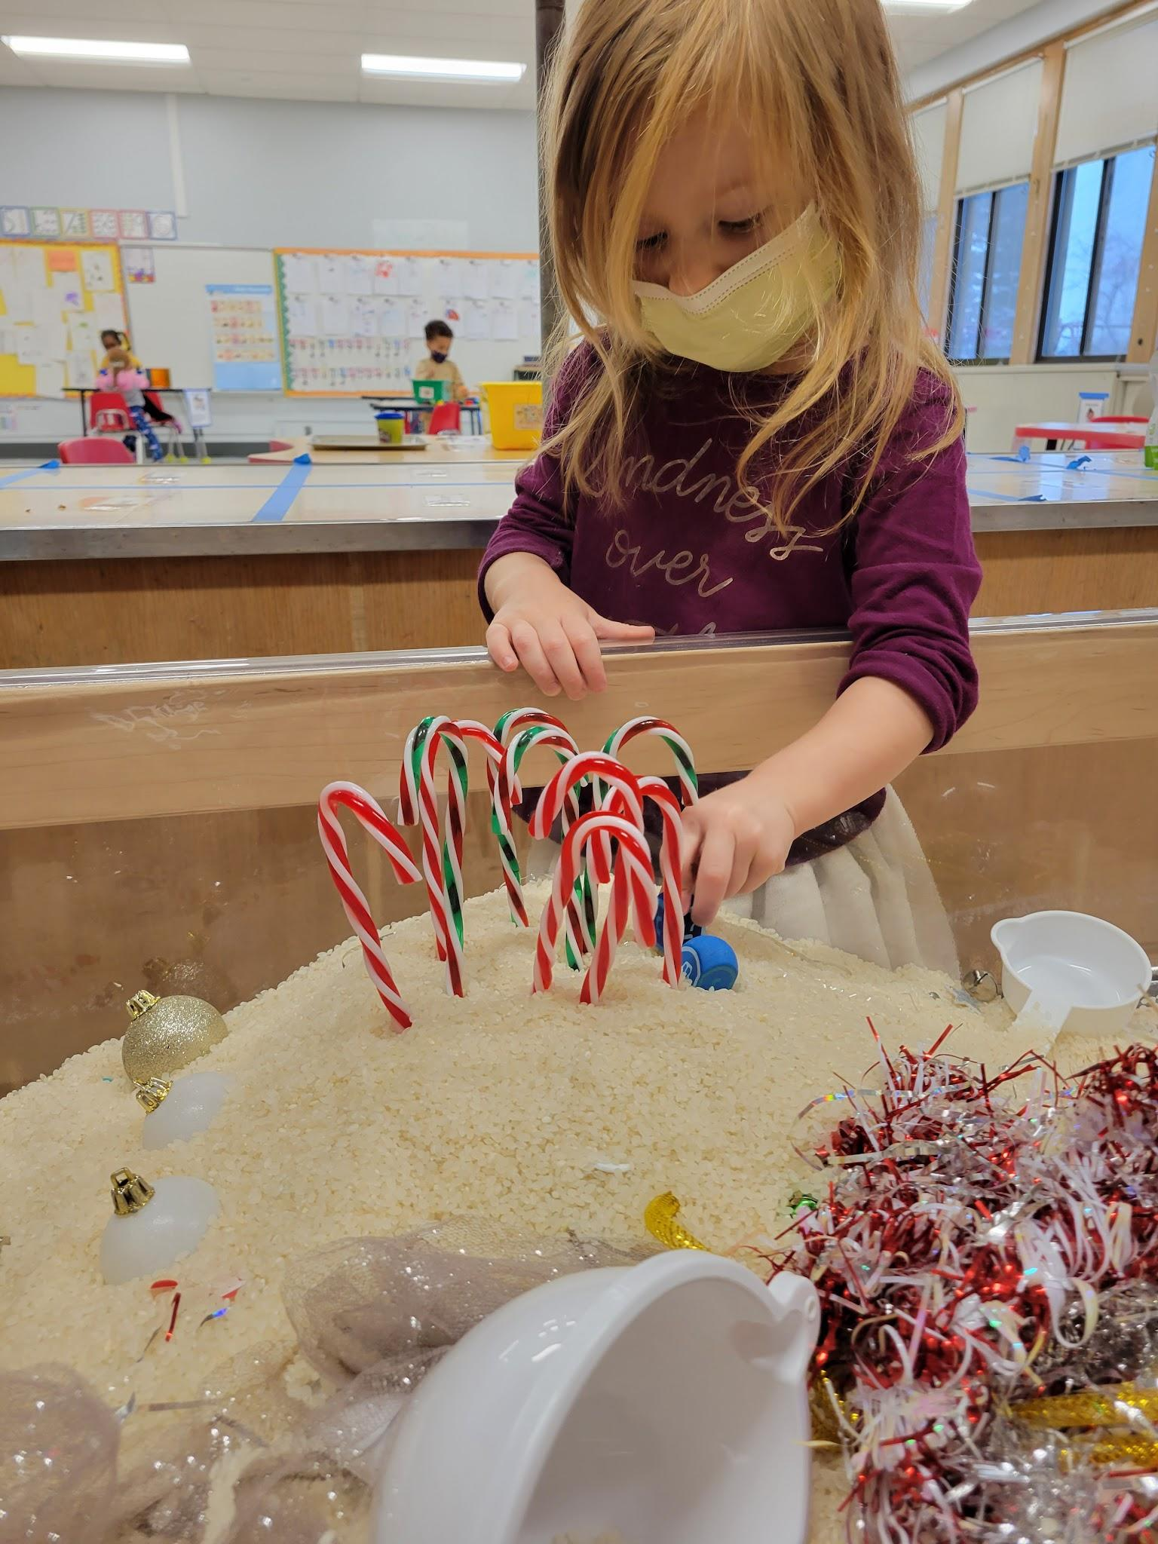
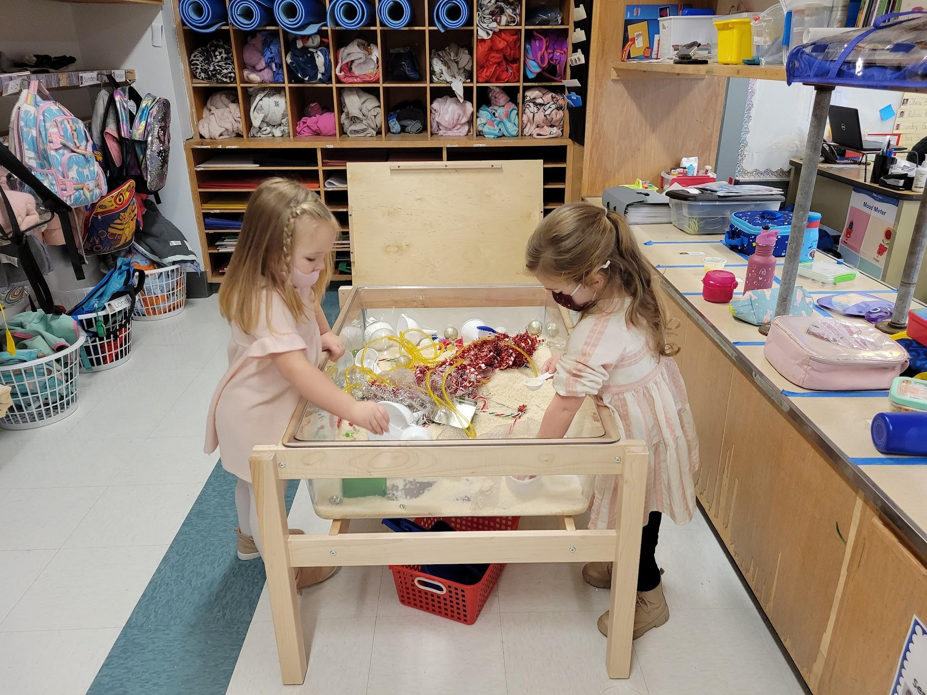
Sensory Bin and Playdough Centers

Slide 10
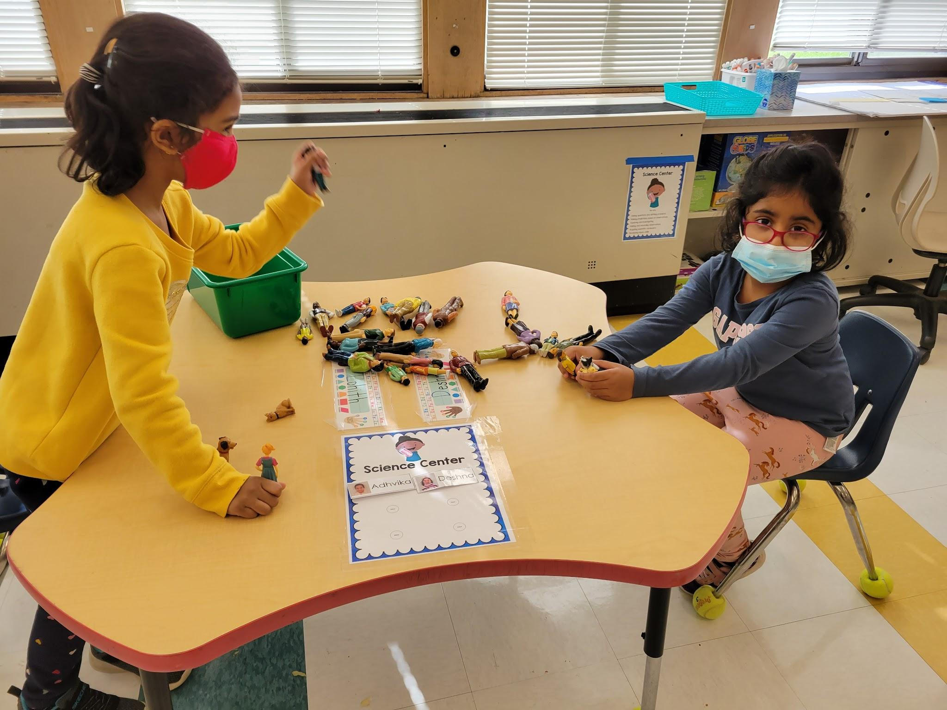
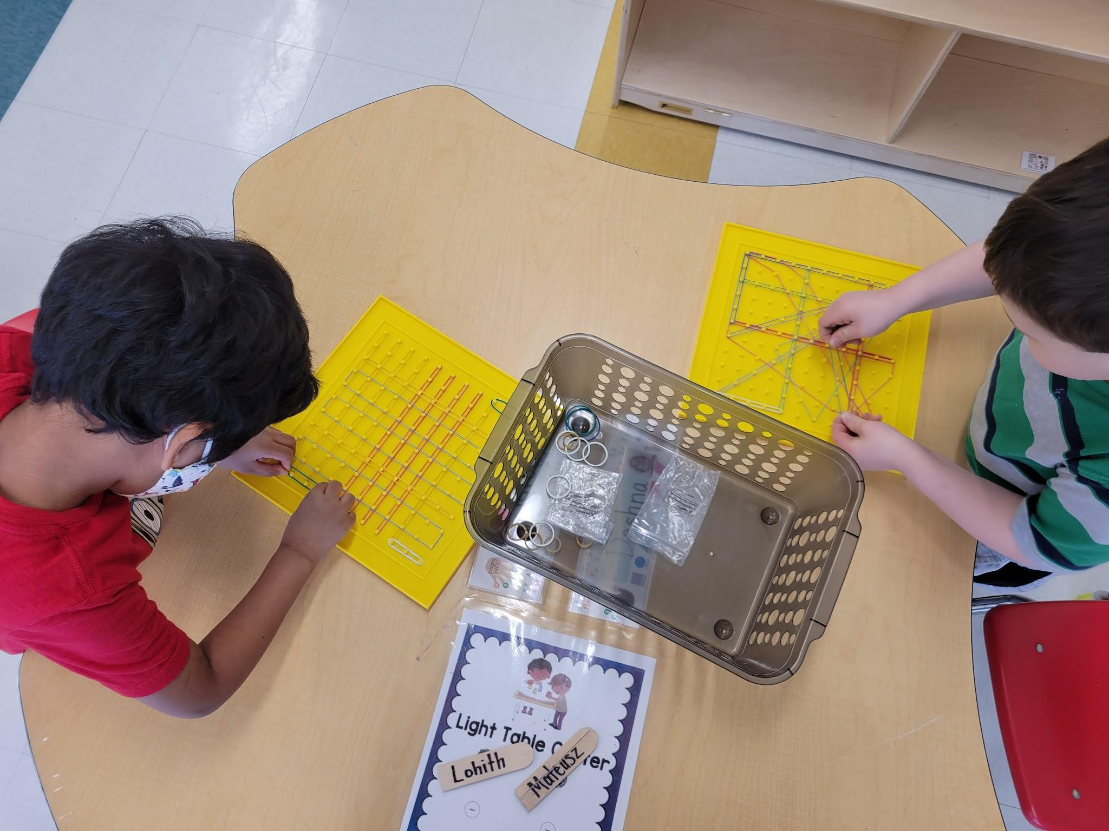
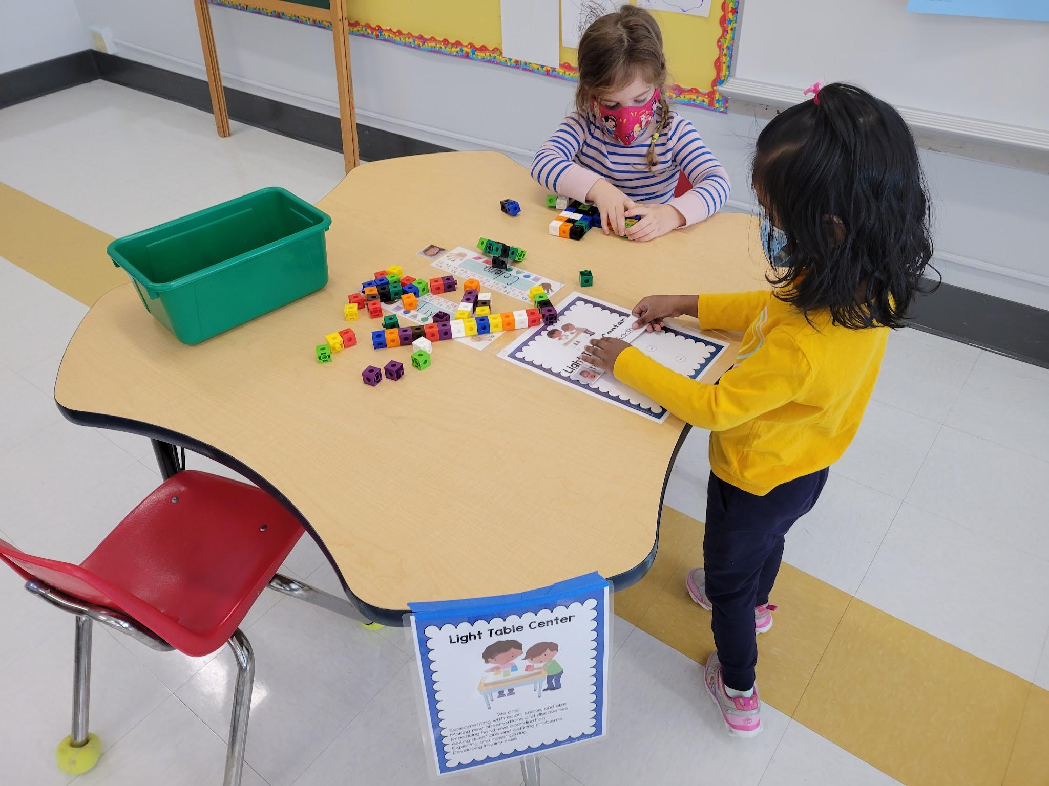
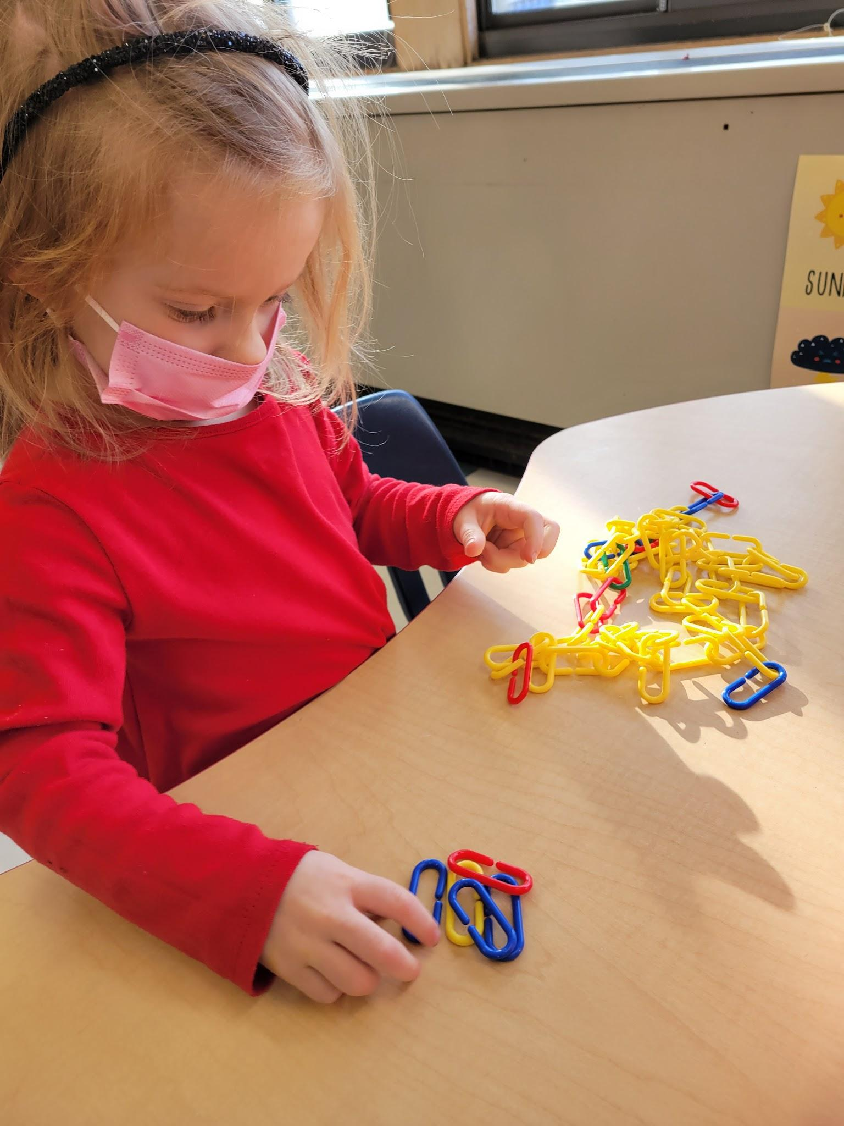
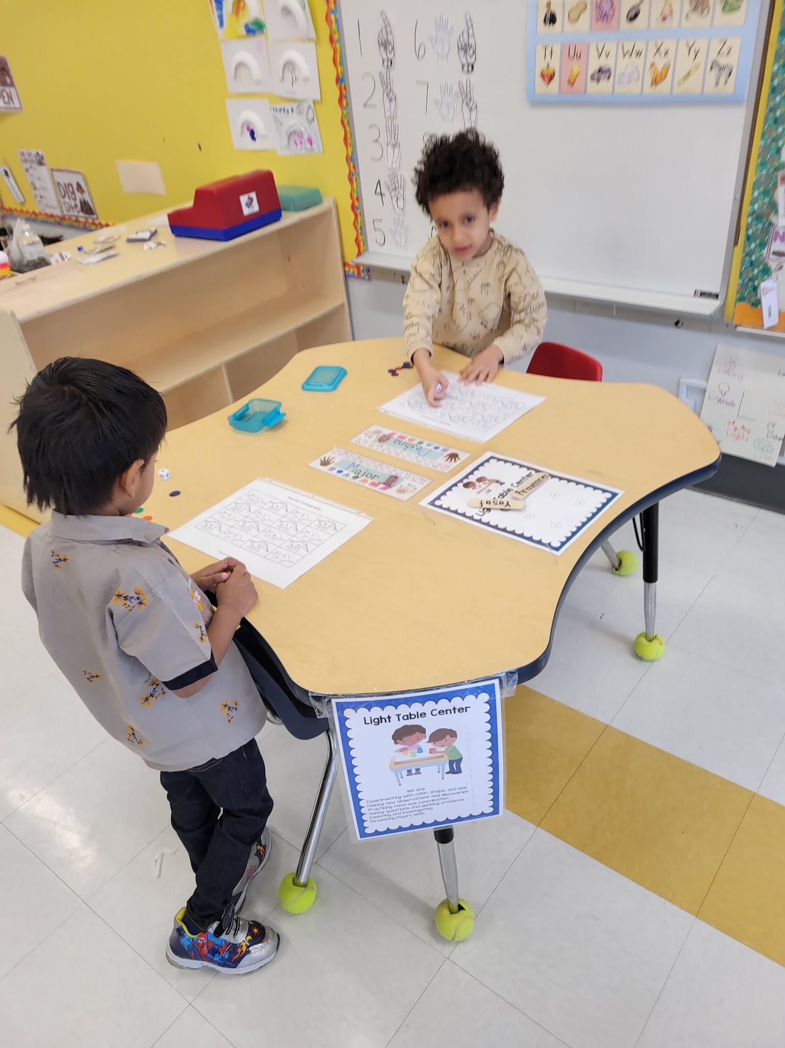
Math and Manipulatives Centers

Slide 11
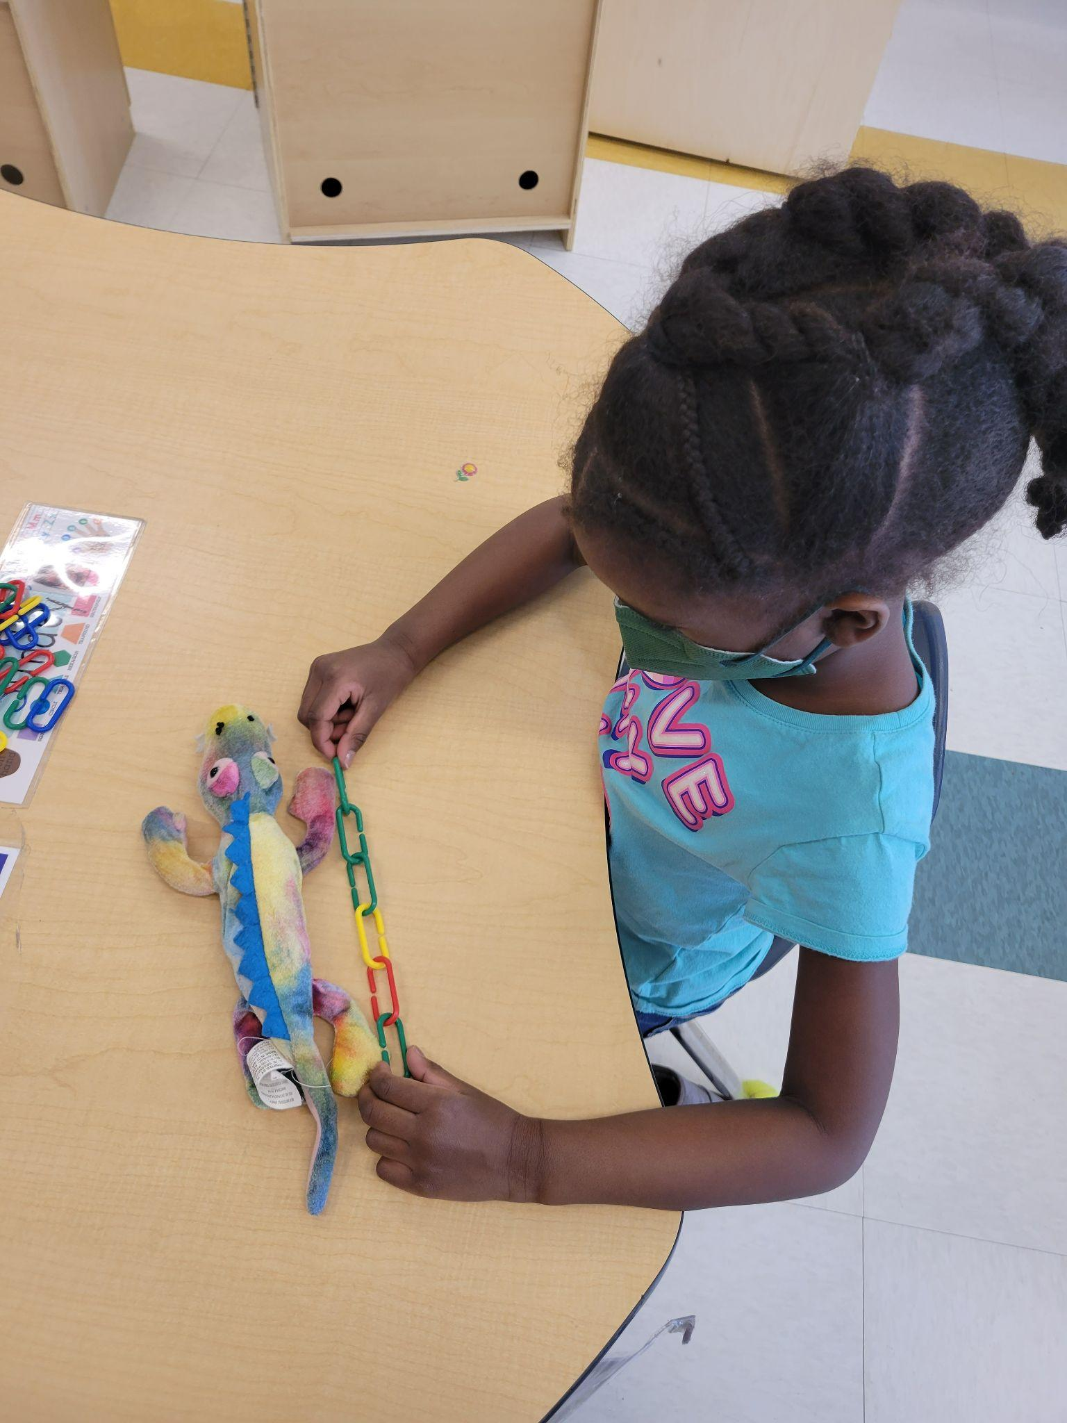
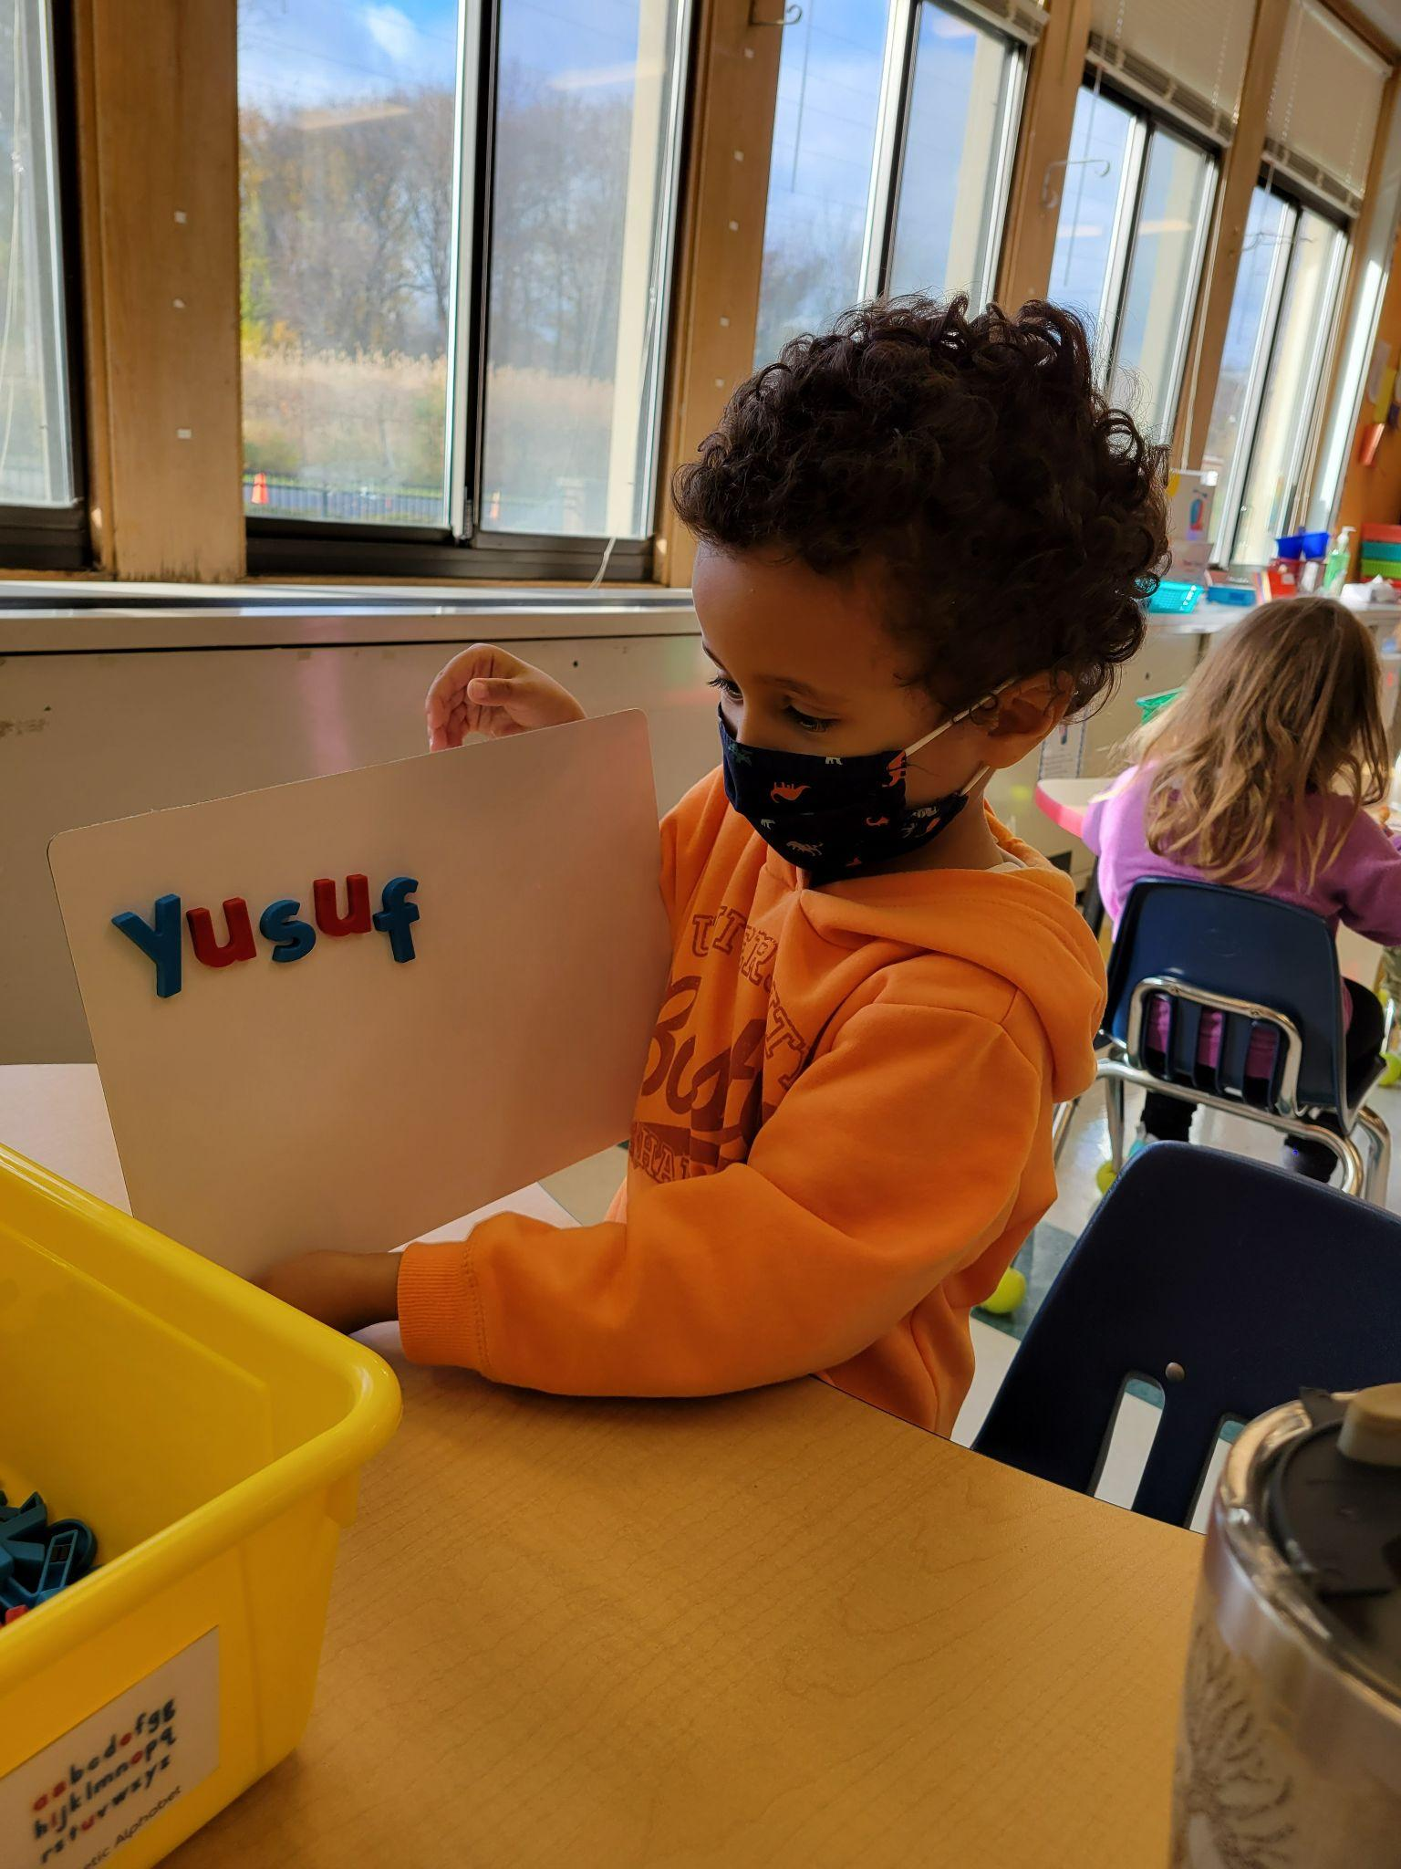
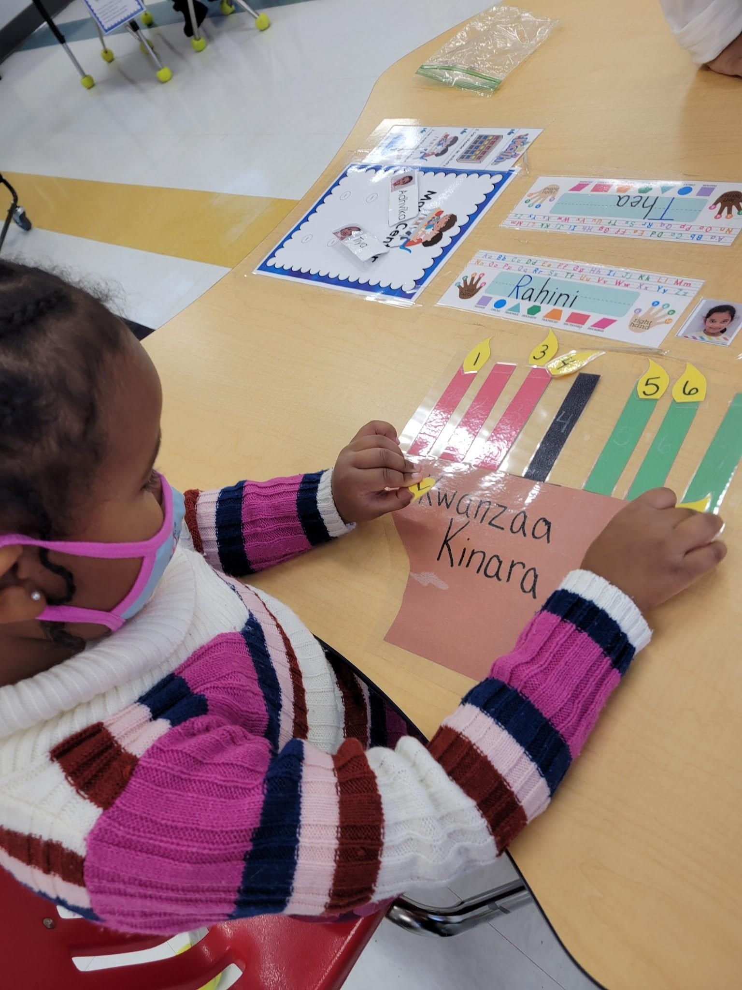
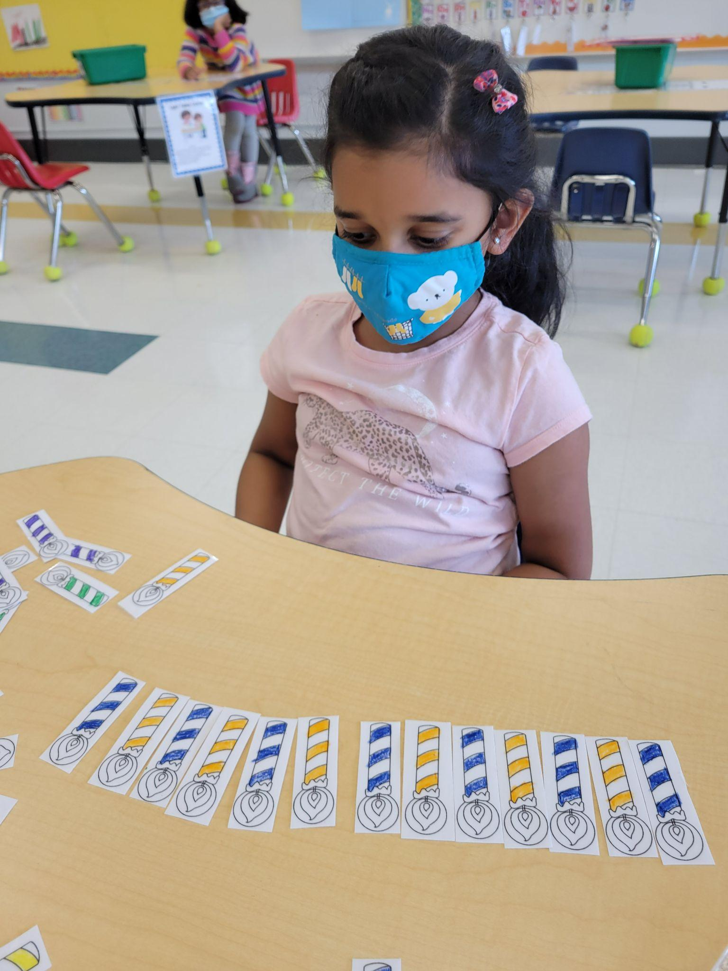
Literacy and Unit Themed Activities

Slide 12
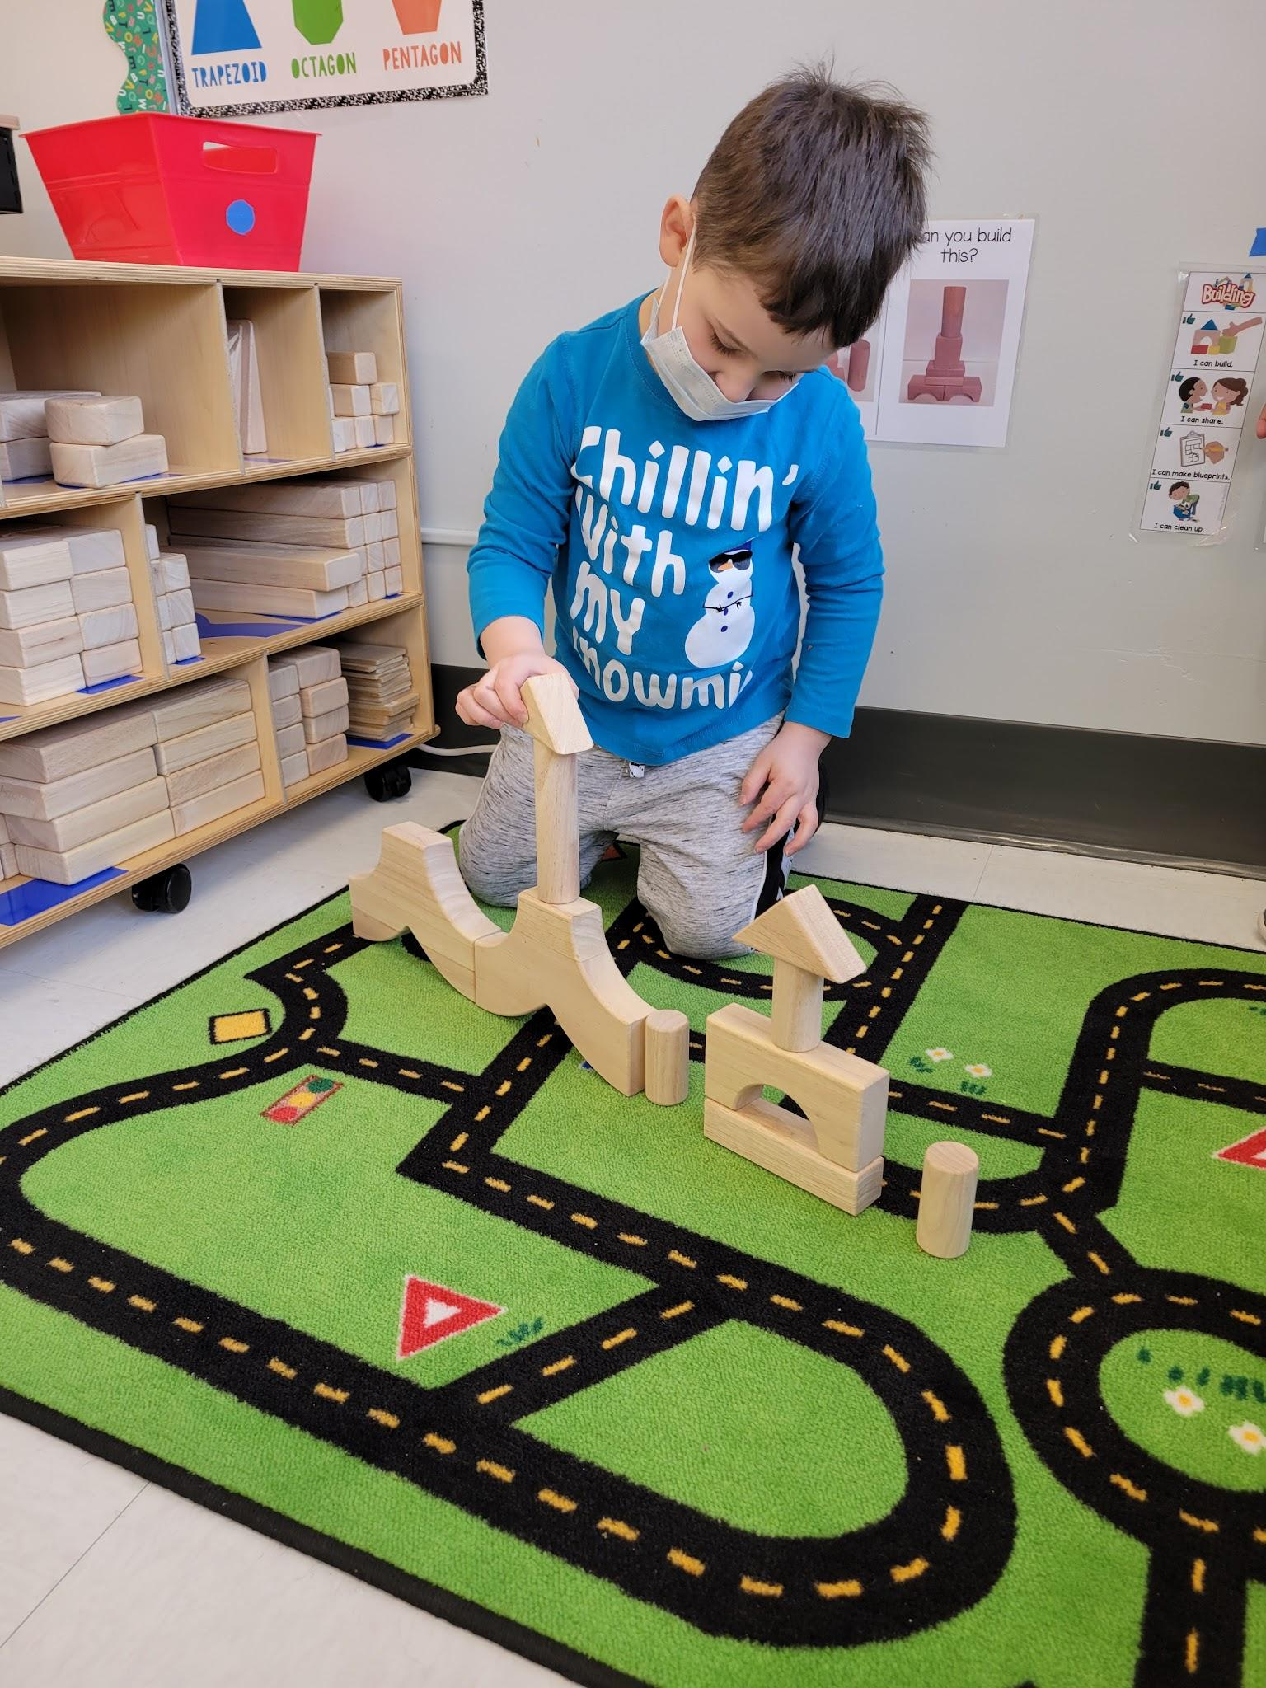
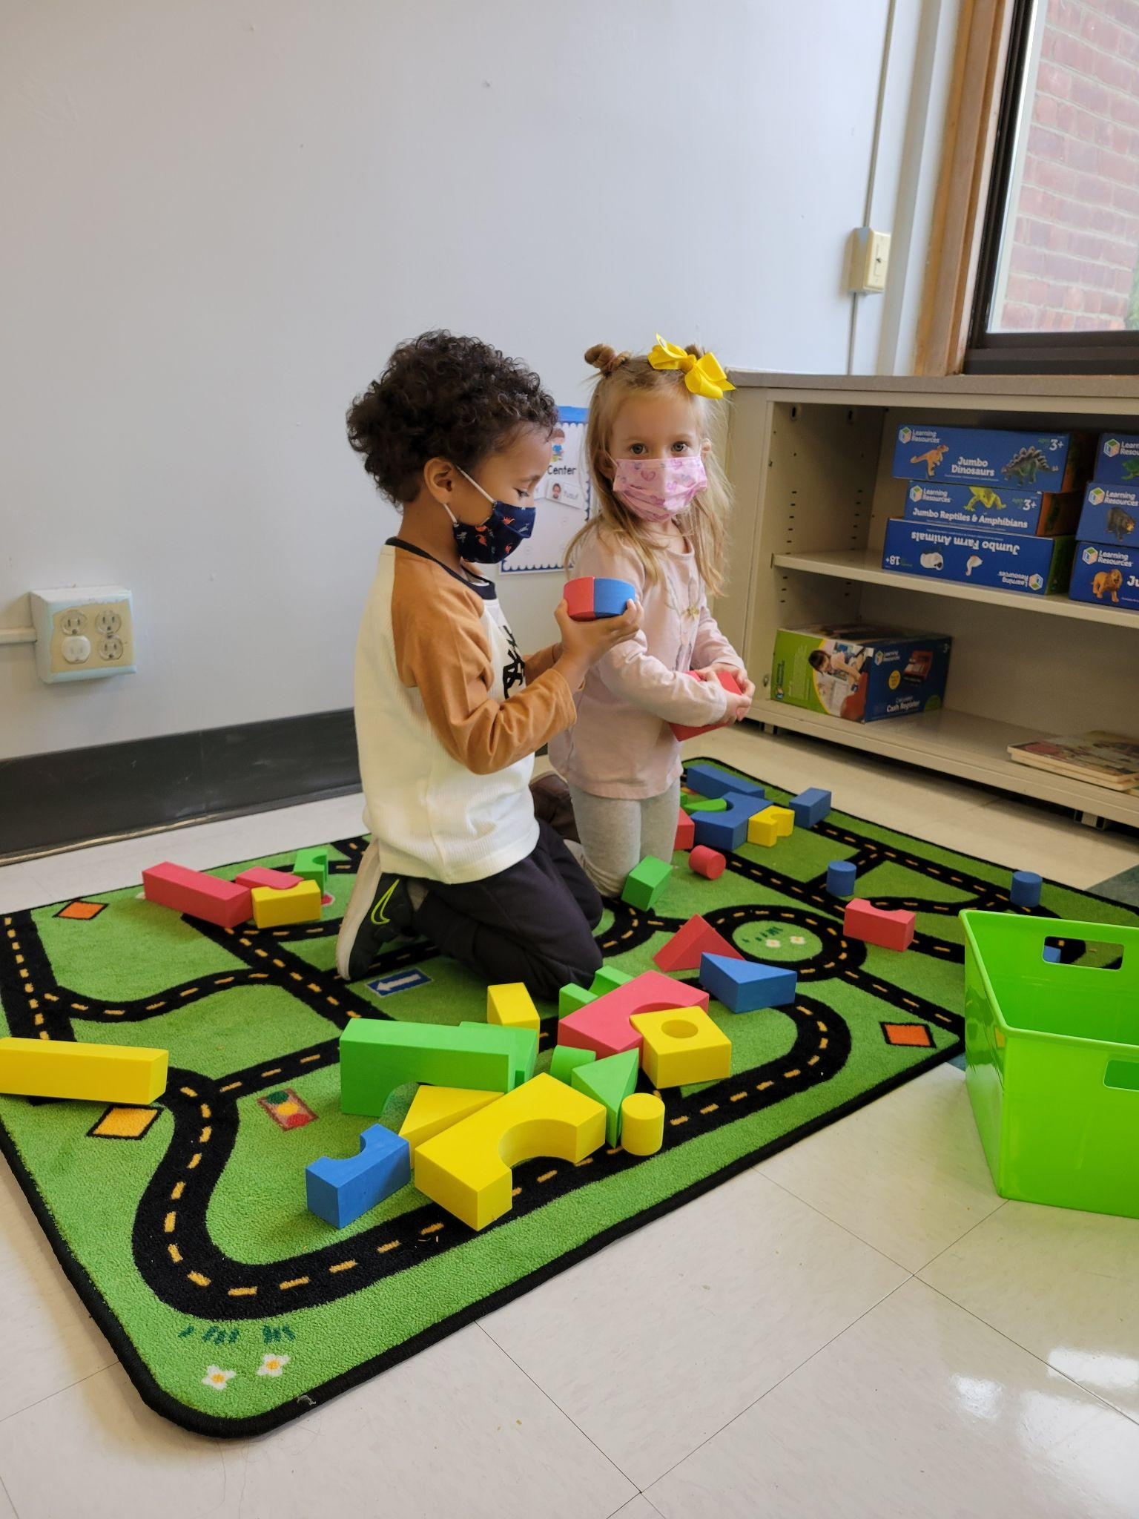
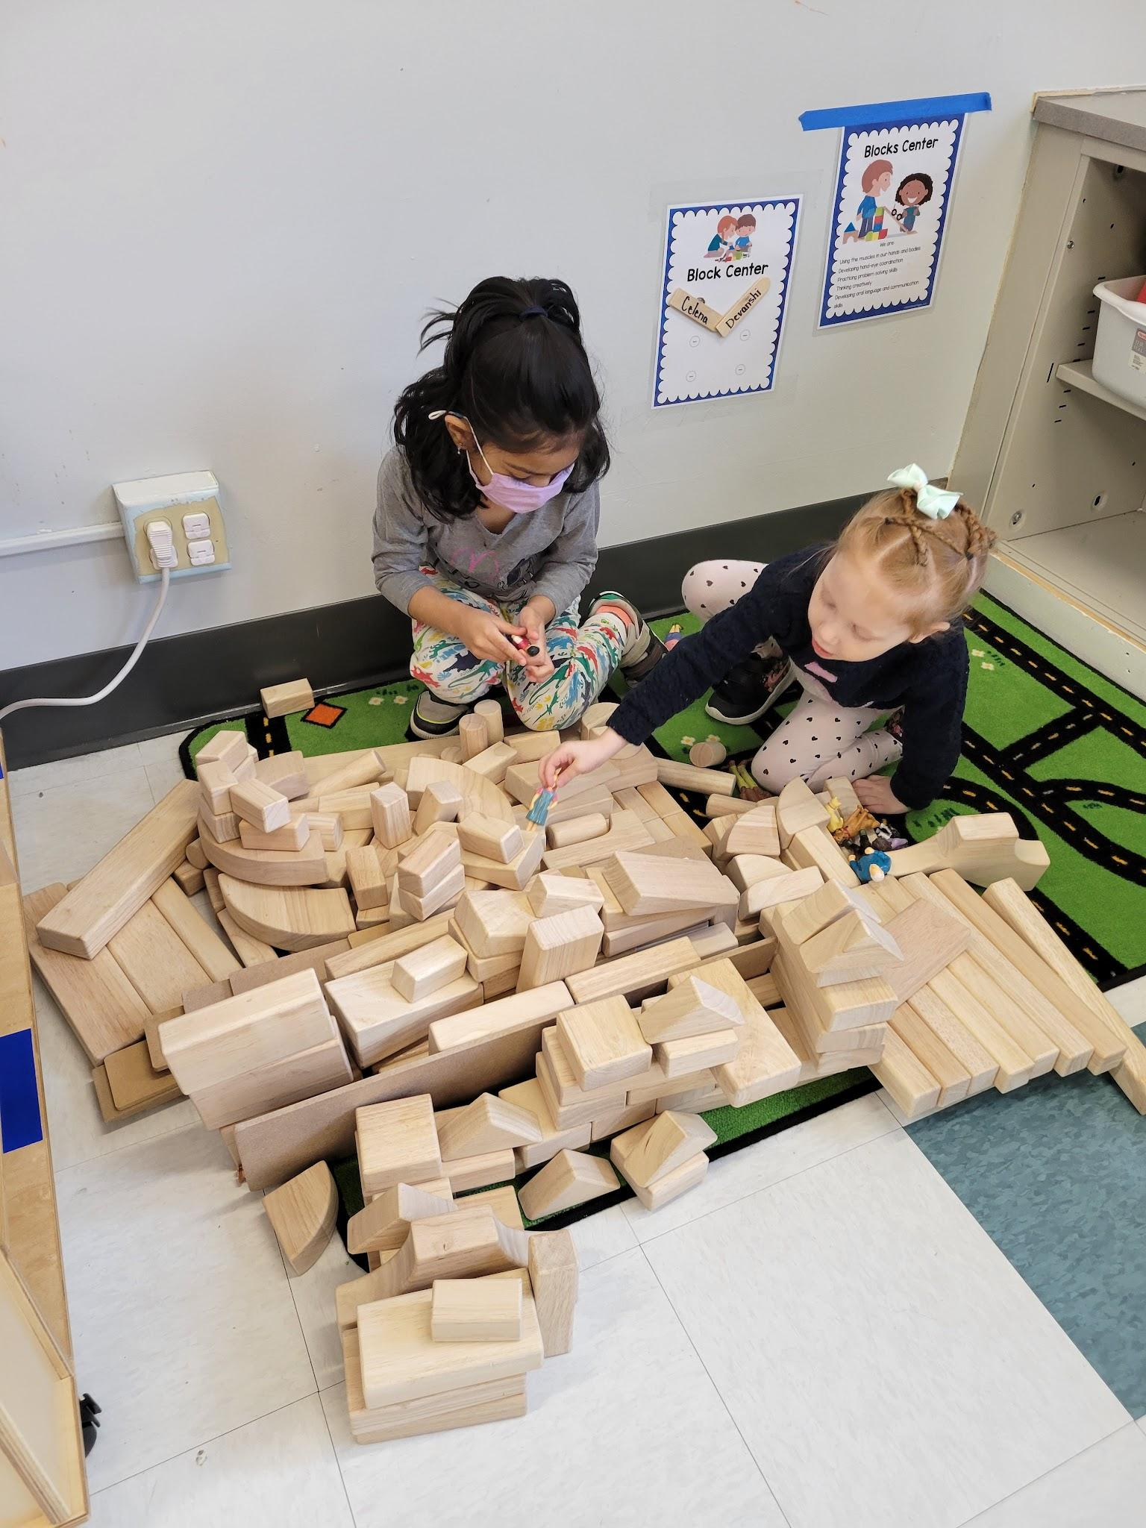
Blocks Center

Slide 13
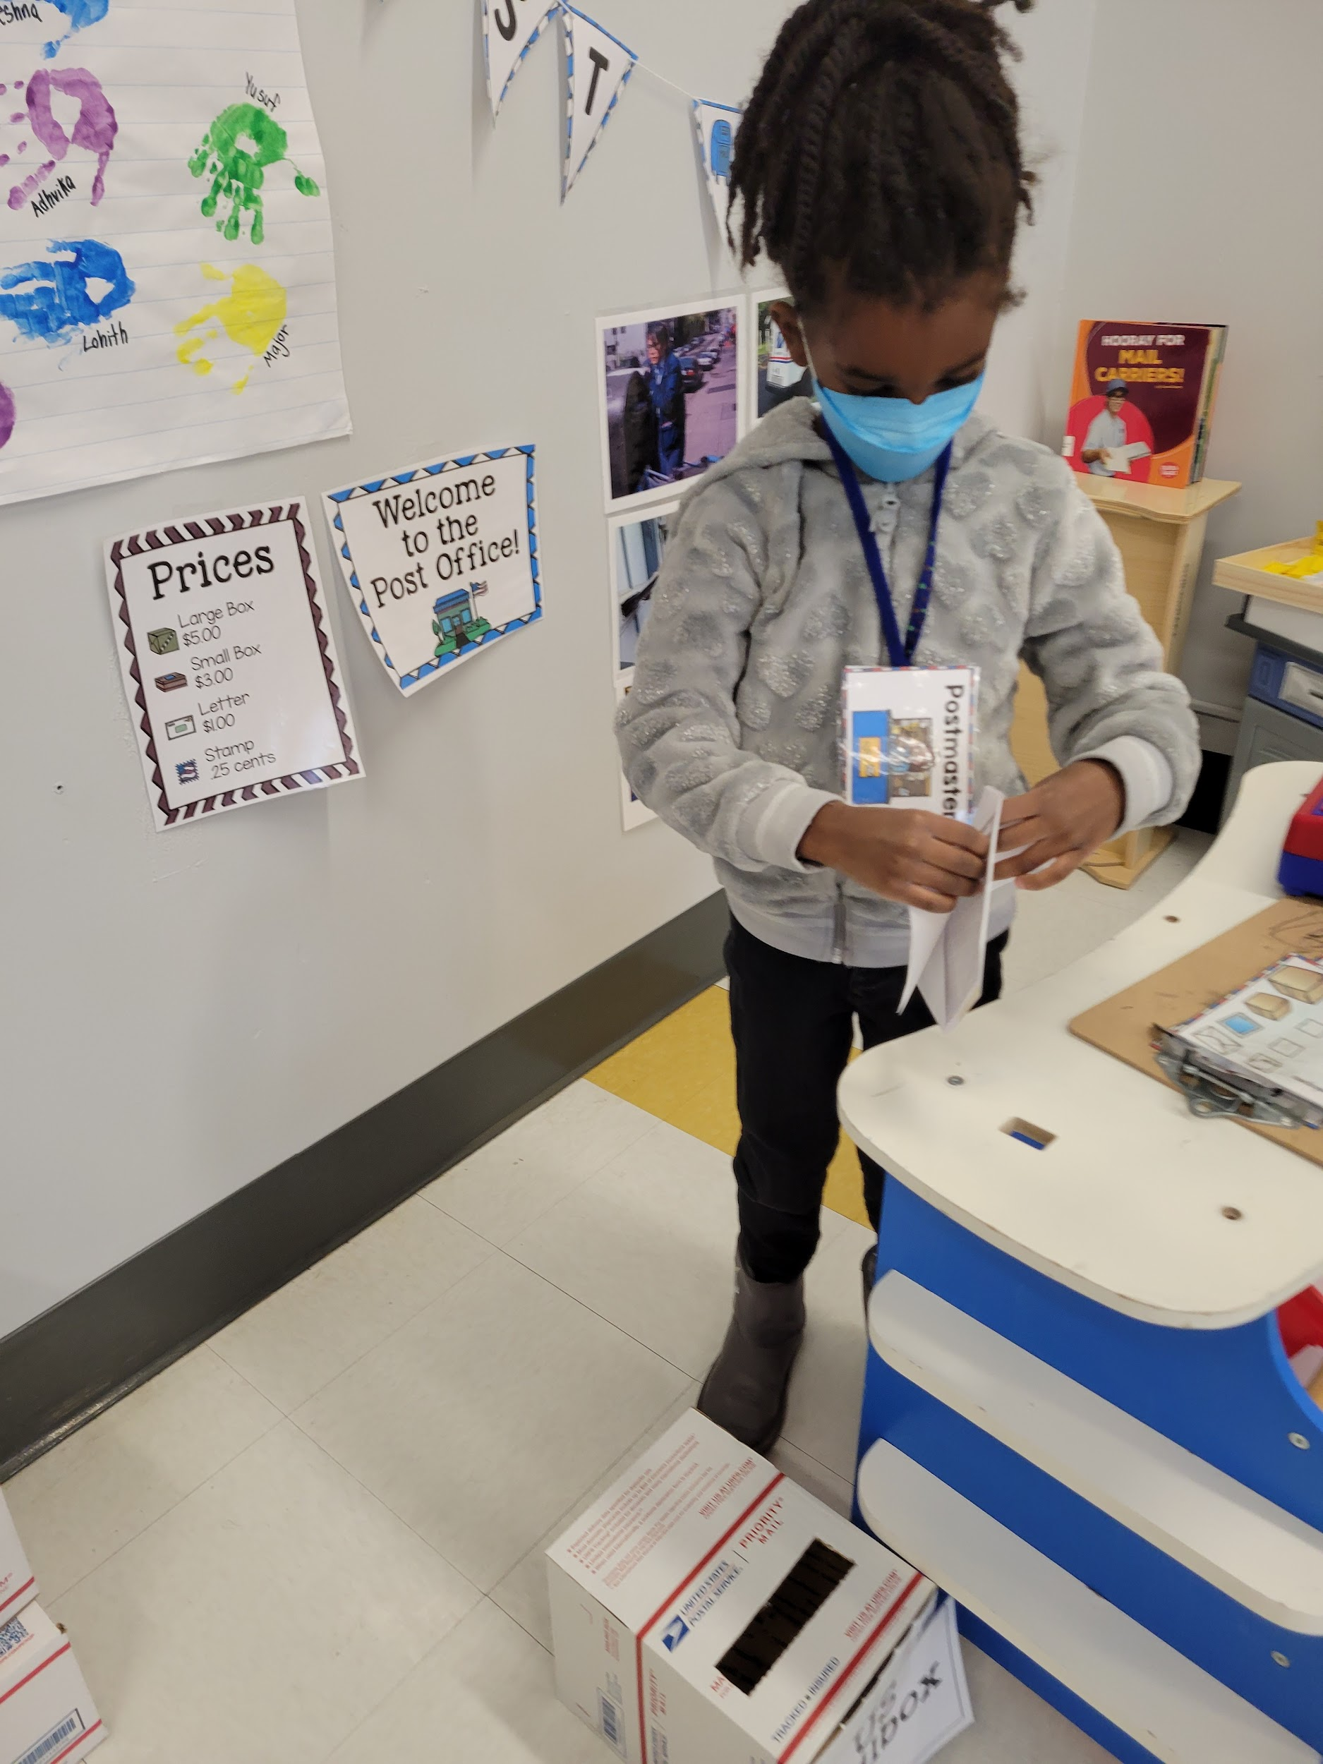
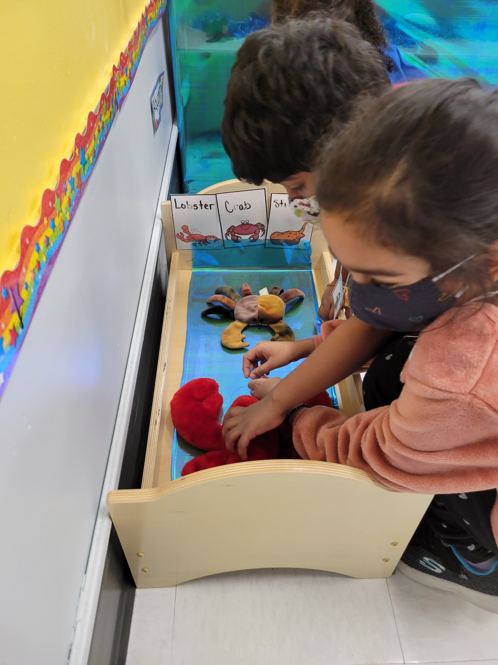
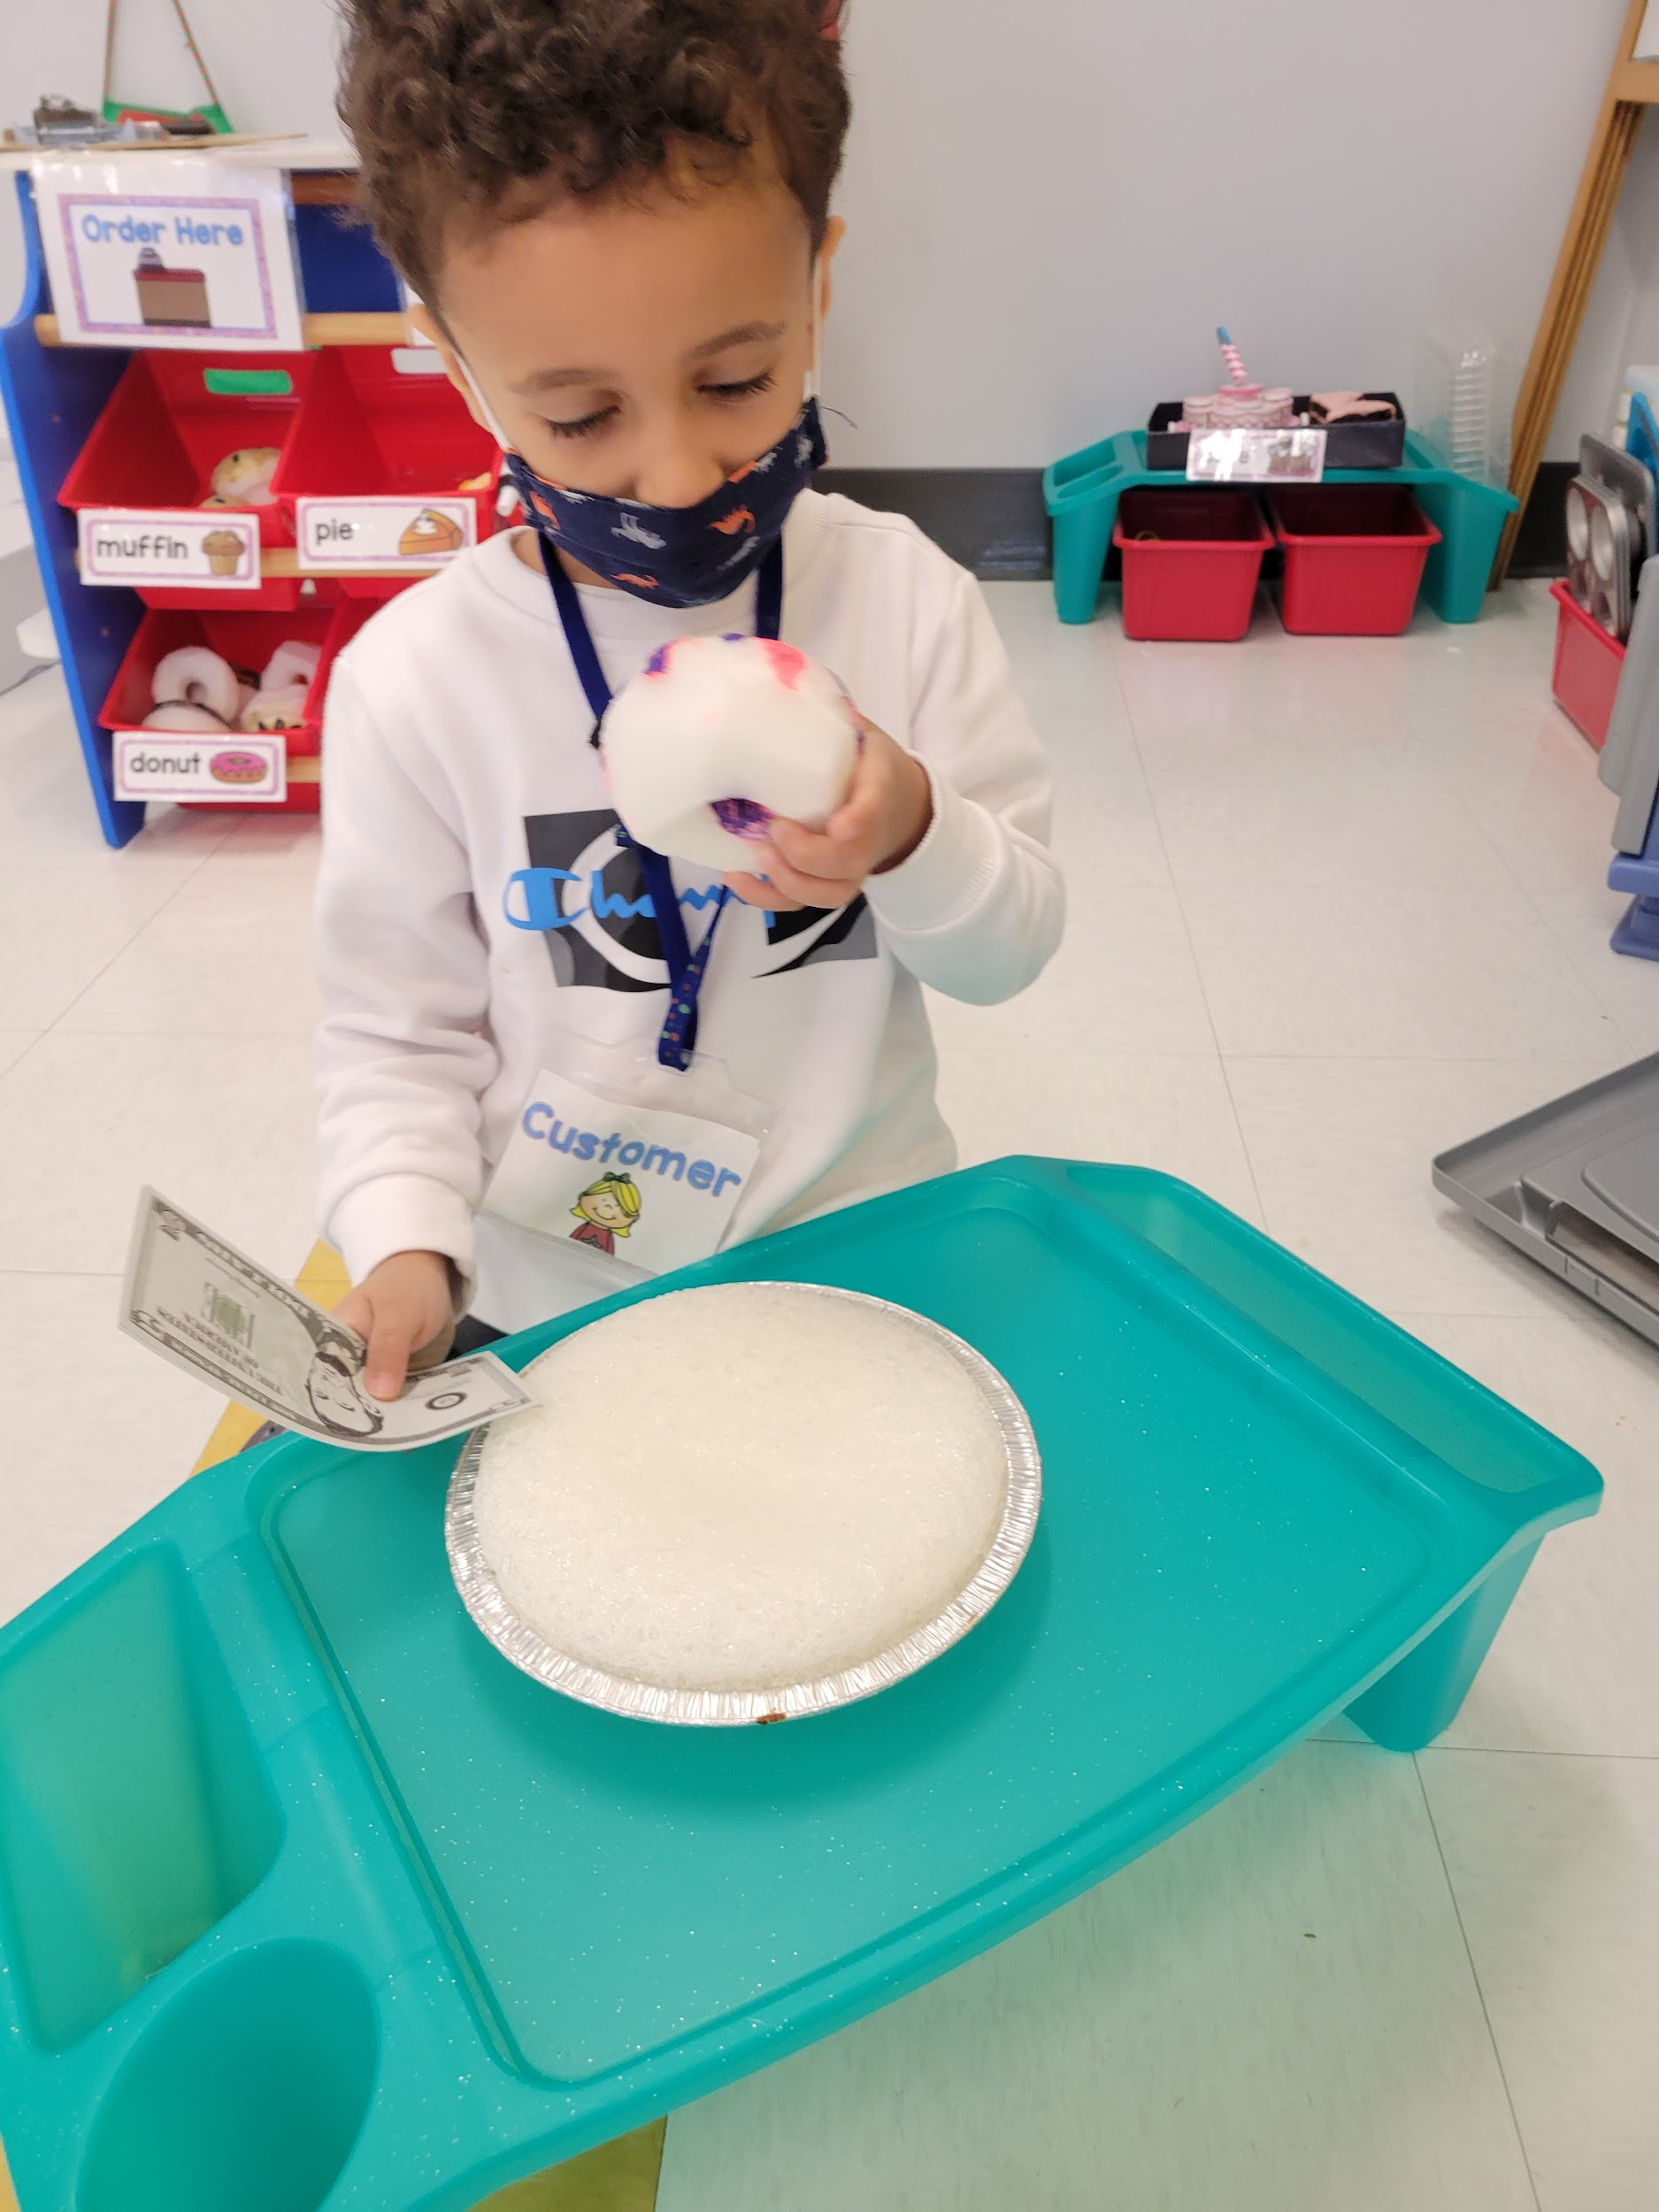
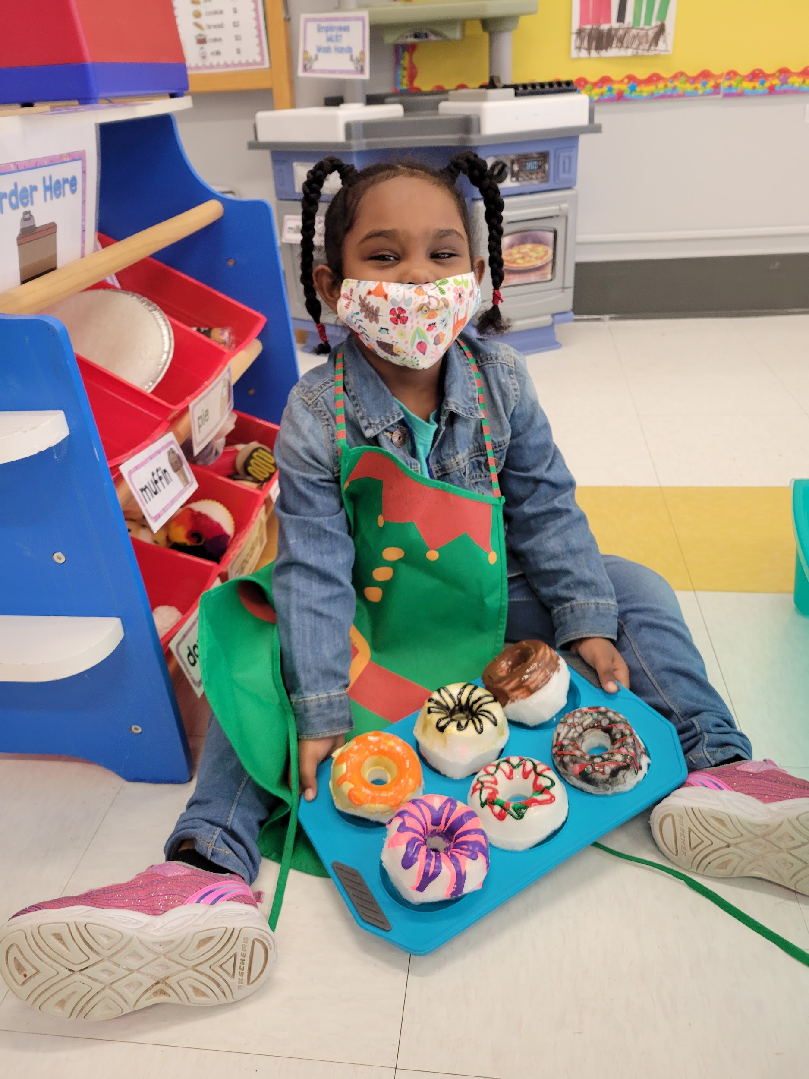
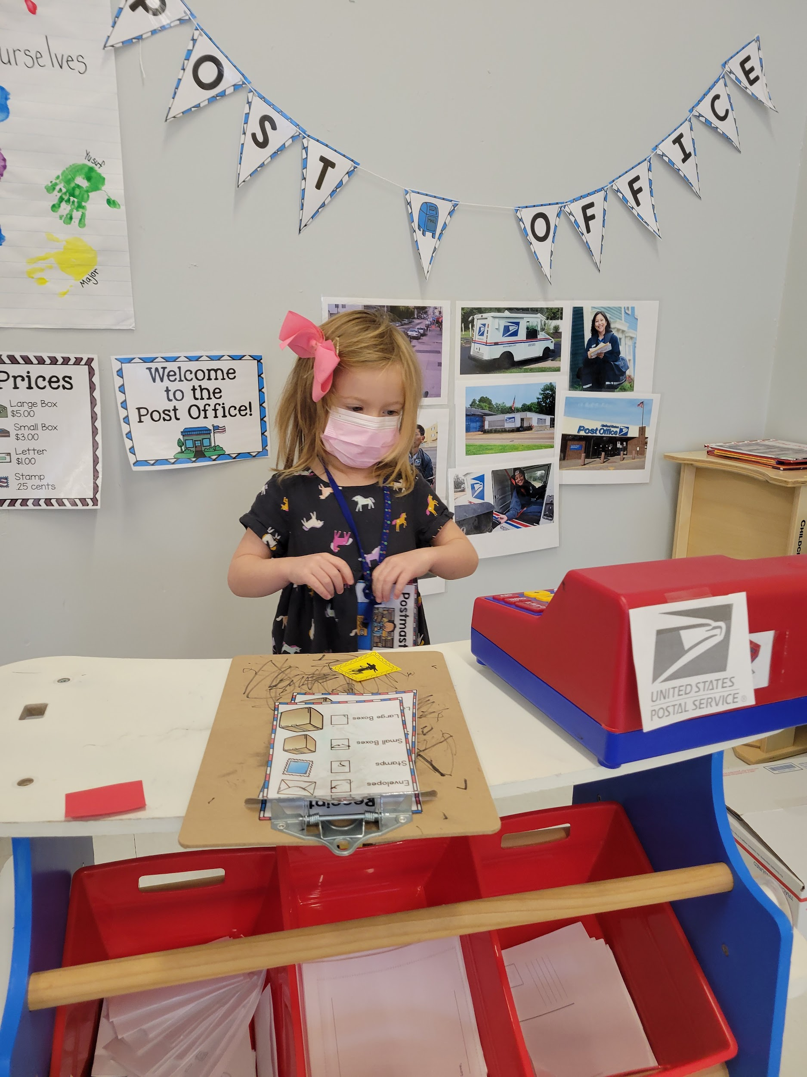
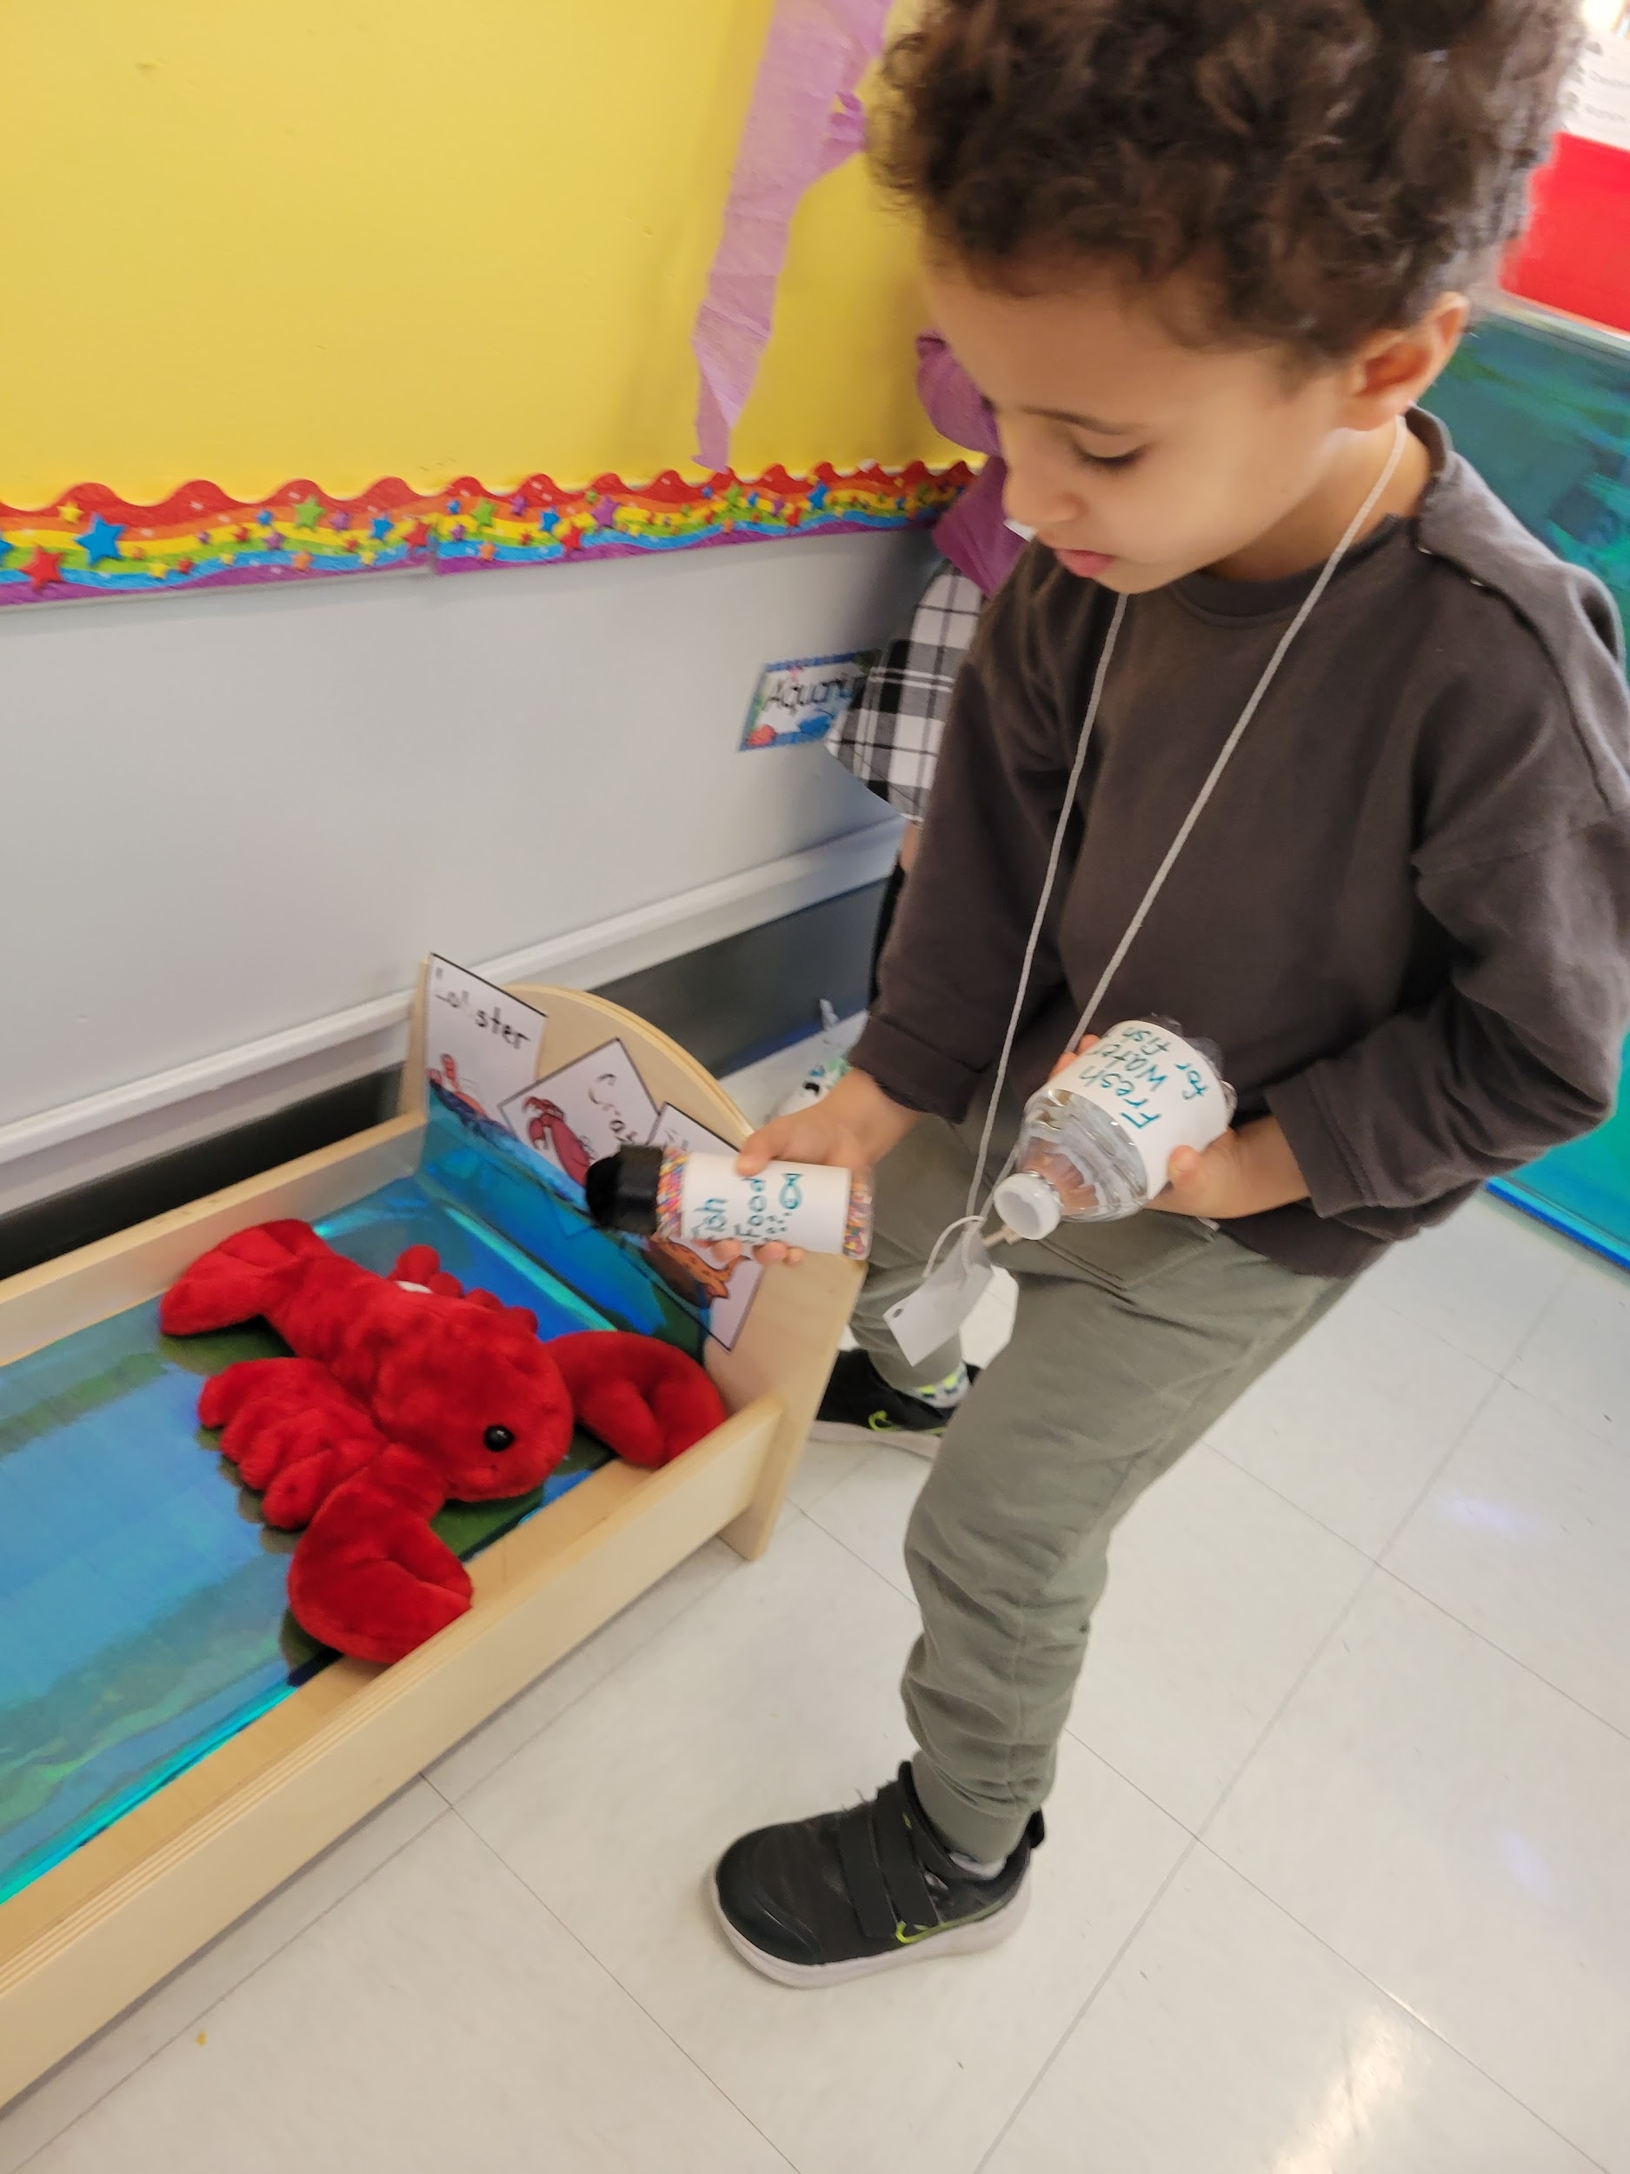
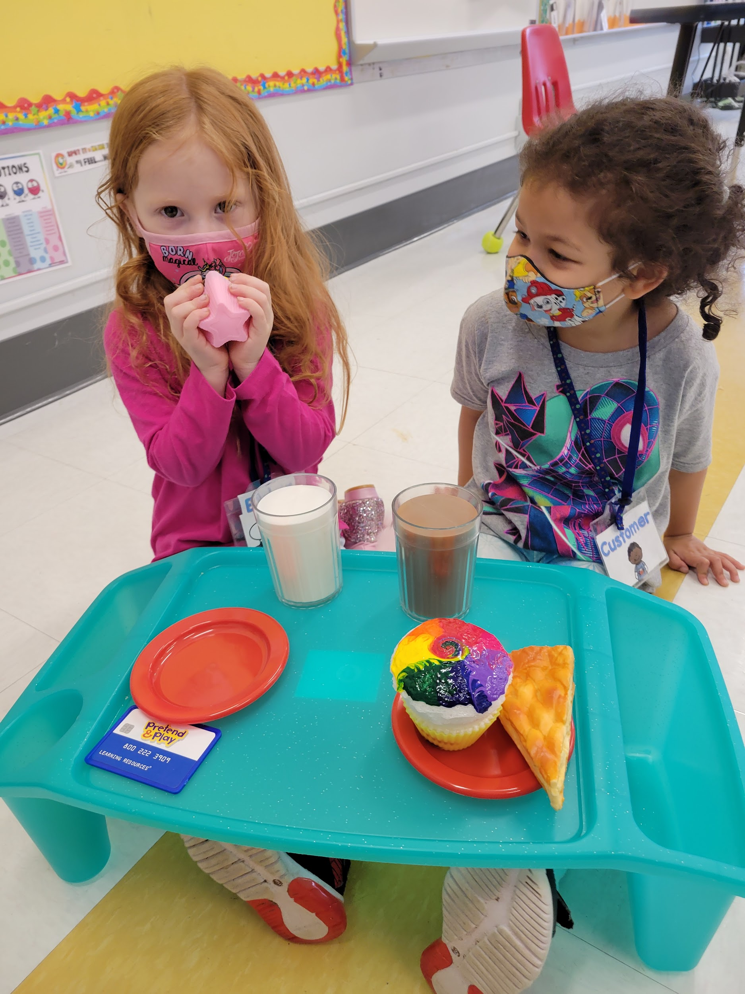
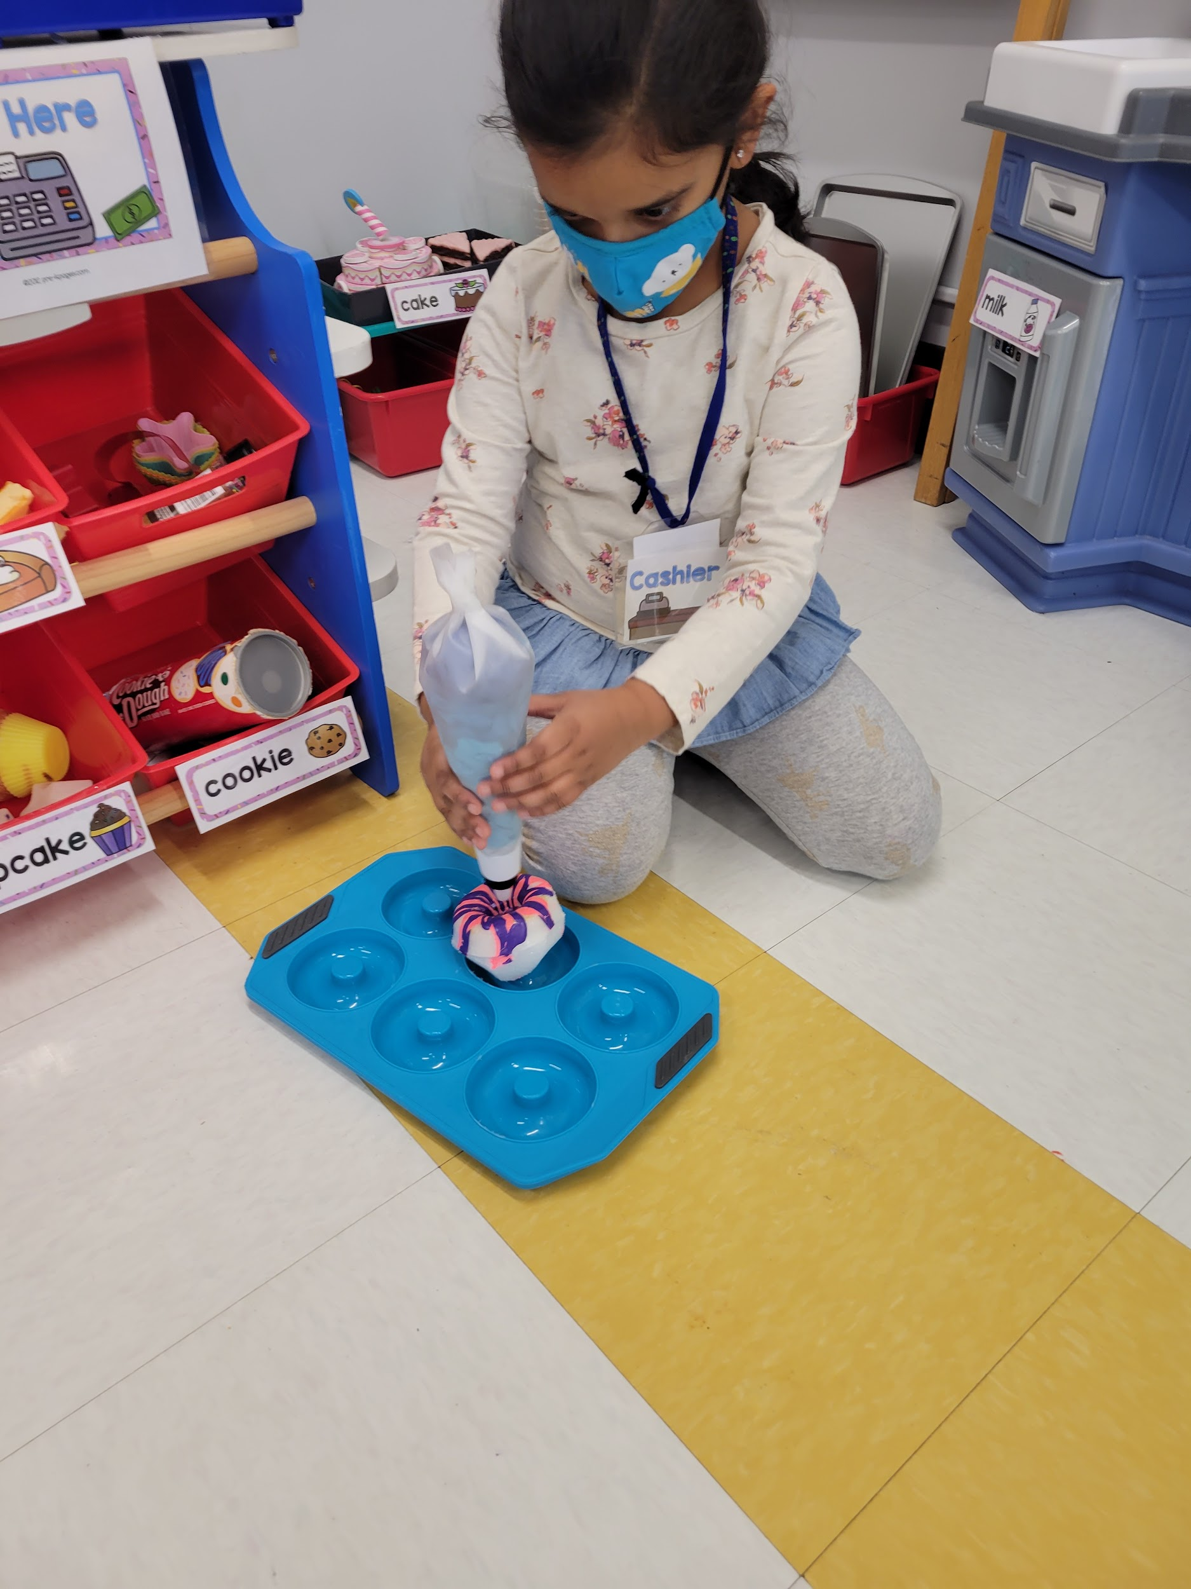
Dramatic Play Center

Slide 14
First few weeks of Pre-K
In the first few weeks of Pre-K we focus on routine, rules, and social-emotional learning. Routine is the strongest thing to help students know what to expect next in their day. Once a routine is established students are able to move around the classroom independently with little teacher assistance.
We learn about smooth drop-off and pick-up (the first few weeks is always the hardest), sharing, forming relationships, creating a classroom community, learn how to take of the classroom, and using words for their needs and wants.

Slide 15
Small Group Instruction
Students are able to join a small group during center time. During this small group time we work on fine motor skills (tracing, cutting, etc) as well as building background knowledge, phonics, expressive and receptive language, vocabulary development and phonemic awareness

Slide 16
